Slide 1
Toxic chemicals and Burning Planet
Tracey Woodruff, PhD MPH
UCSF
April 10, 2024

Slide 2


Healthier Environments for Healthier People
Targeted Research * Improved Clinical Care * Just Public Policy
Nothing to Declare

Slide 3



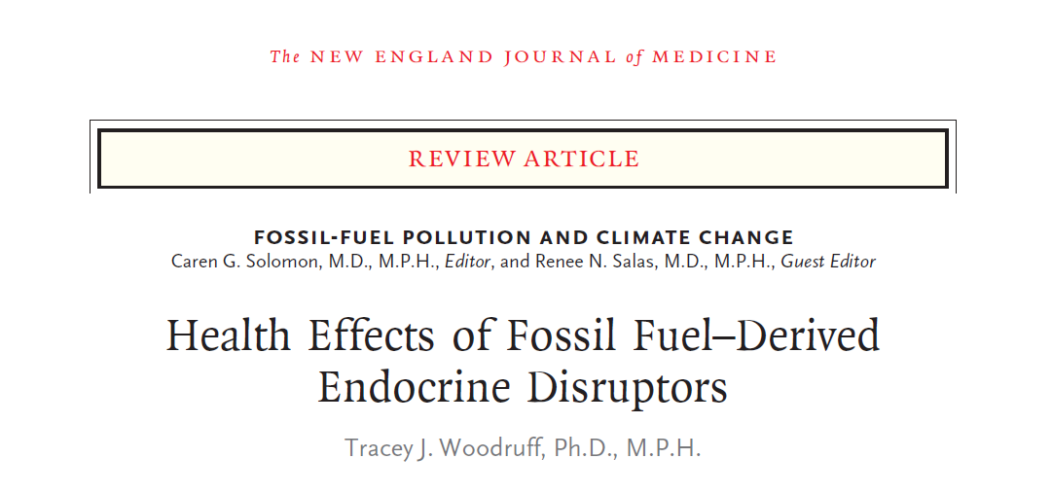
Building the foundation for action
CHE/UCSF Summit
NG: PFOA & Birthweight (Sufficient)
NAS 2017 Systematic Rev Prenatal Phthalates & Male Reprodev (Presumed)
PBDEs & Neurodev (Presumed)
2024
2007
2009
2011
2013
2015
2021
2014
2017
FIGO opinion
Env Repro Health 2015
Endocrine Society 2nd statement EDCs
ACOG Committee opinion
Env Repr Health
ACOG Committee 2nd opinion
Env Repr Health
Navigation Guide Published
Navigation Guide Systematic Review Method Conceived
Endocrine Society Consensus
EDCs

Slide 4
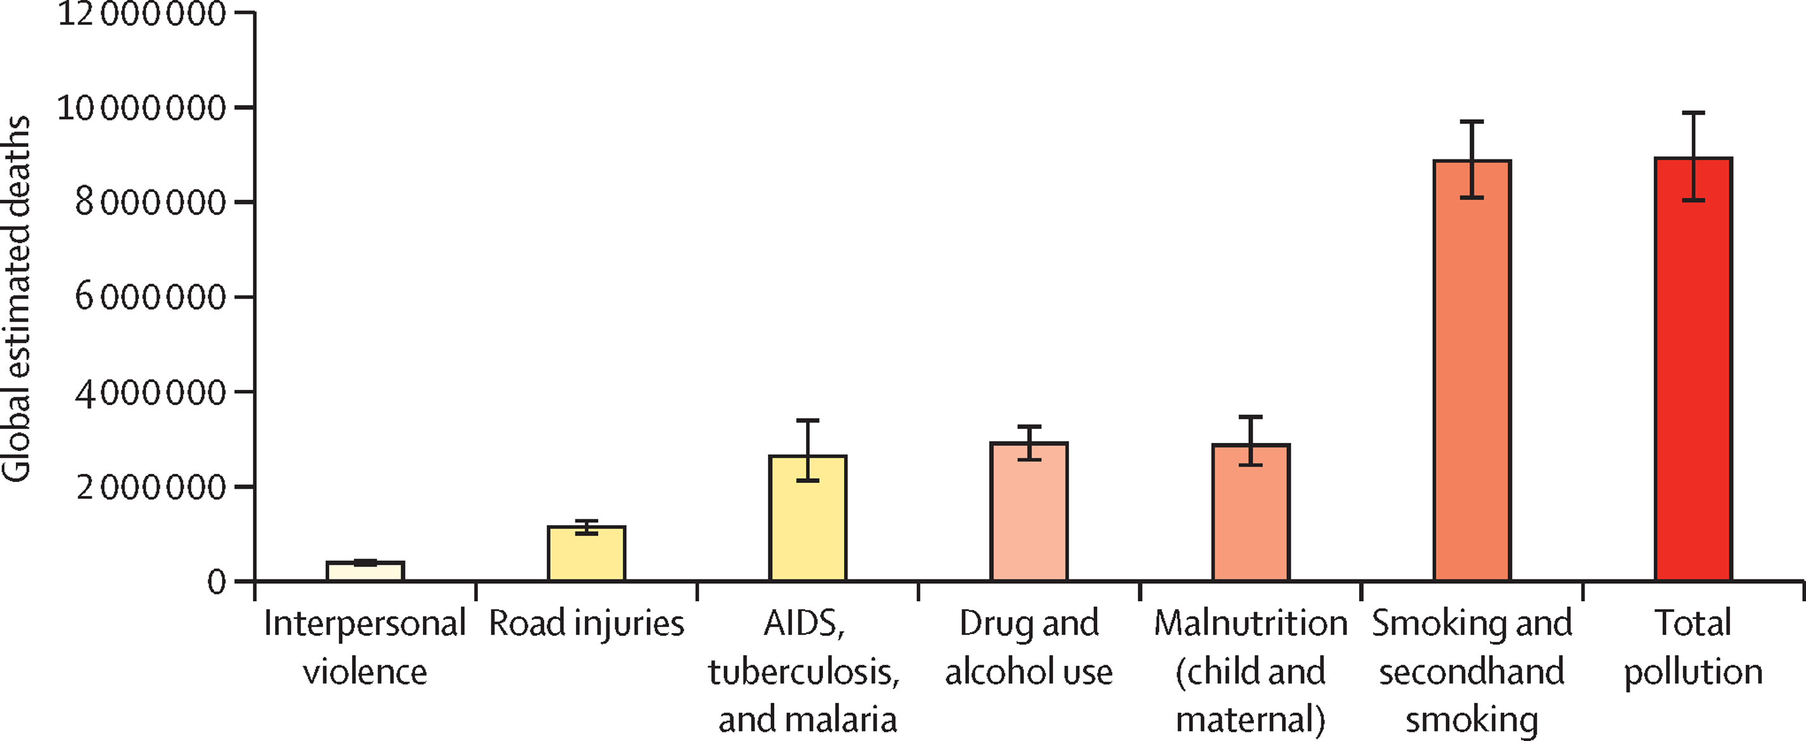
The Leading Cause of Premature Death Globally is Pollution – 9 million deaths annually
Air and water pollution, pollution from lead and other chemicals, and toxic occup exposures
Figure 1
Chemical pollution is at least 1.8 million, but underestimated since <5% of chemicals have adequate data due to insufficient laws
The Lancet Planetary Health 2022 6e535-e547DOI: (10.1016/S2542-5196(22)00090-0)
Fuller et al. Lancet Planet Health 2022 PMID: 35594895.

Slide 5

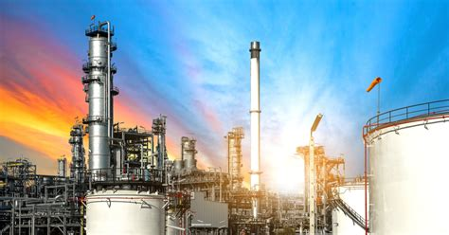

Fossil Fuel - Petro-chemical connection
Production of ethylene as a feedstock is more lucrative than the sale of methane
and ethane for fuel, heat, or electricity

Slide 6
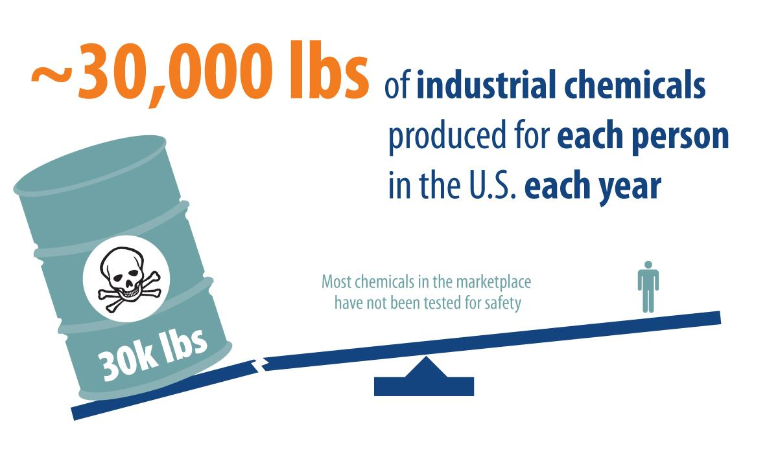


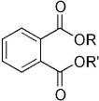

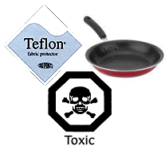


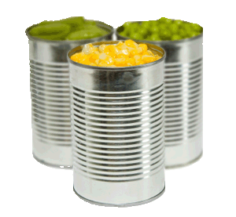
PFAS
Flame Retardants
Phthalates
Phenols
EPA Chemical Data Reporting 2015
Notes:
l

Slide 7
https://www.env-health.org/wp-content/uploads/2020/03/FREIA-infographic_EN_sm.pdf

Slide 8
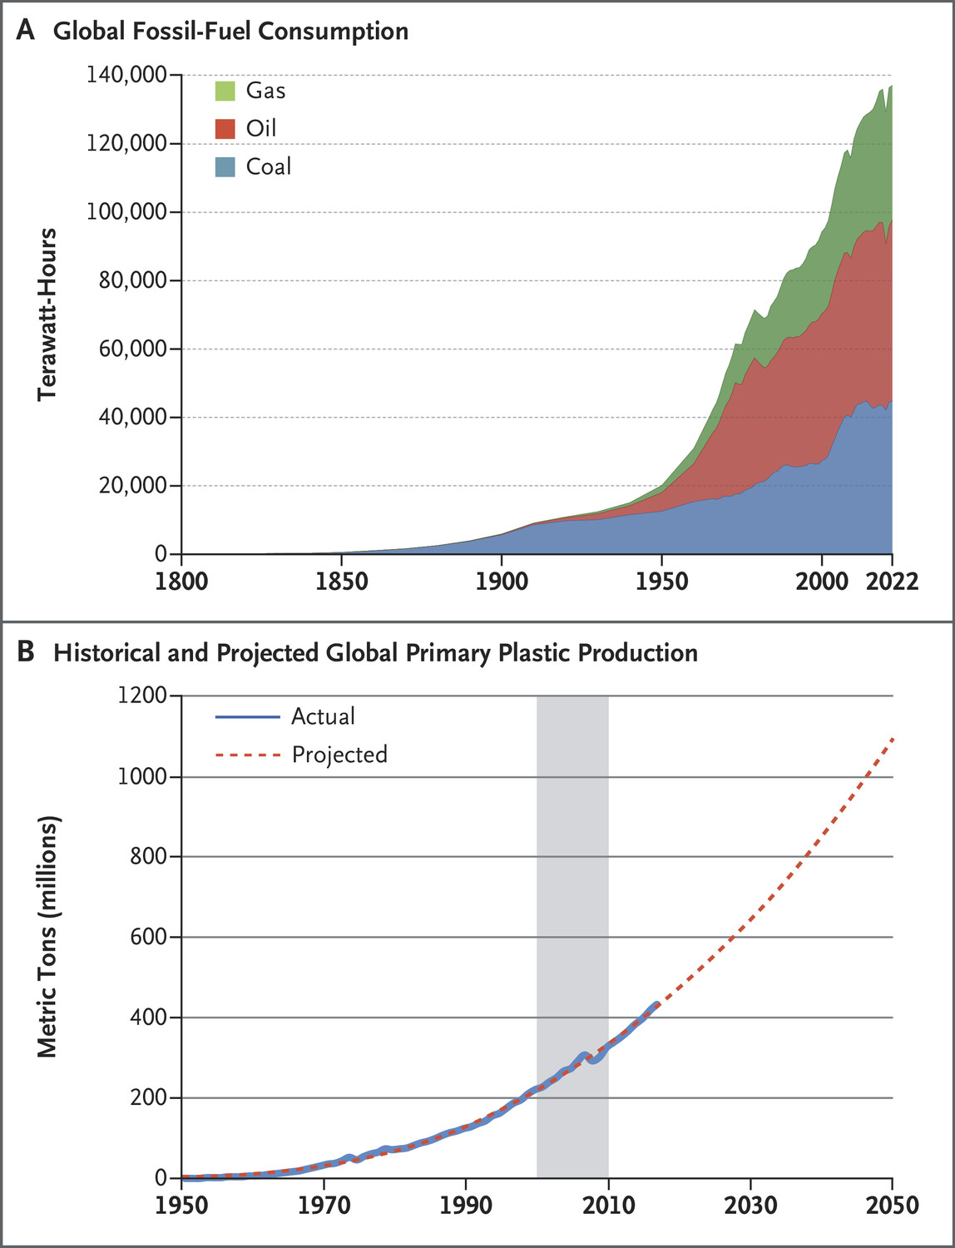

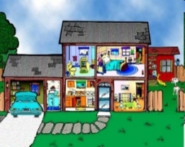
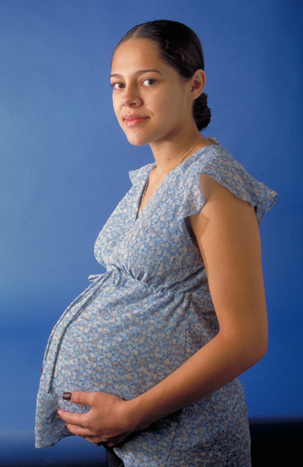

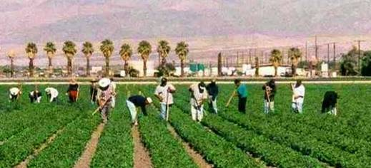

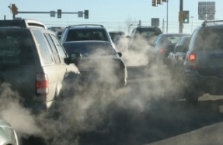


Slide 9
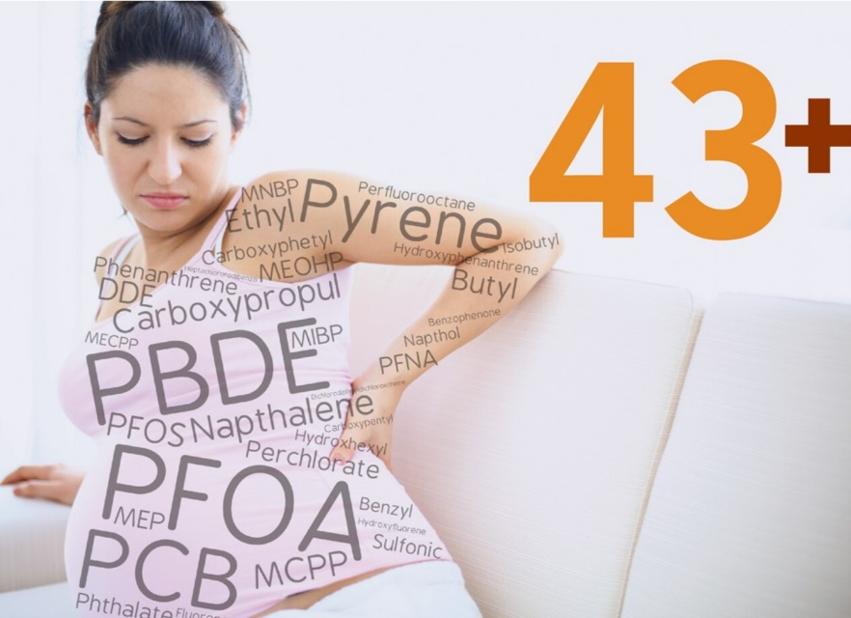
Toxic chemical exposures start in utero
Exposures to chemicals are not equal
Multiple chemical are higher in Hispanic and Black pregnant people
industrial chemicals found in virtually every U.S. pregnant woman
Insecticide
Phthalate alternative
Benzophenones
Neonicotinoids
Bisphenols
Fungicides
Pyrethroids
Herbicides
Parabens
Phthalates
 | BP8 | 4-OHBP | BP1 | BP3 | BPA | BPF | BPS | BPZ | 2,4,5-T | PNP | PCP | 2,4-D | ATZ | CLO | IMI | NDMA | NIT | THX | TCP | SUF | DCCA | FPBA | BzPB | BuPB | EtPB | MePB | PrPB | ∑DINCH | ∑DEHP | ∑DPHP | ∑DiDP | MHPP | MBzP | MEP | MiPP/MPrP | MMP | MnBP/MiBP | MOP | FLUOs | NAPs | PHENs
Race/ethnicityª
Non-Hispanic Black/Other/multiple | ñ |  | ò | ò |  | ñ | ñ |  |  |  |  |  |  | ò |  |  |  |  |  | ò |  | ò |  |  | ñ | ñ | ñ |  | ò |  |  |  |  | ñ |  |  |  |  | ñ | ñ
Hispanic ethnicity | ñ |  | ò | ò |  | ñ | ñ | ñ |  |  |  | ñ |  | ñ |  | ñ |  | ñ |  |  |  | ò |  | ñ | ñ | ñ | ñ | ñ | ñ | ñ | ñ | ò | ò | ñ | ñ |  | ñ |  | ñ | ñ
ª Compared to non-Hispanic White
=
positive association, p < 0.05
=
positive association, p < 0.2
=
negative association, p < 0.05
=
negative association, p < 0.2
Buckley JP,. Environ Sci Technol. 2022 May PMCID: PMC9118548; Woodruff et al EHP 2011

Slide 10
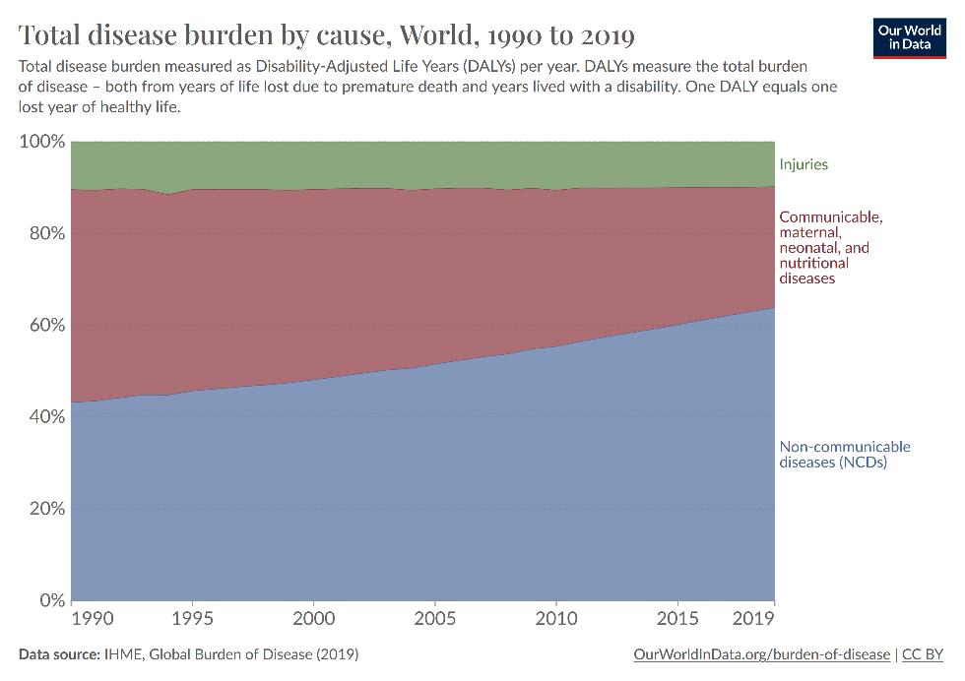
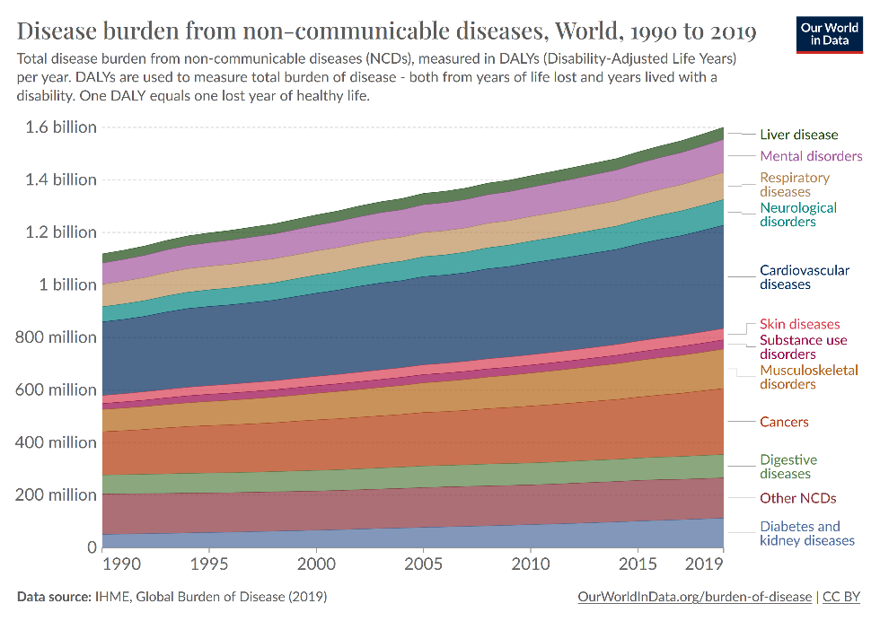
Shift from communicable to noncommunicable disease since 1990
1990 - communicable diseases highest share at 46%
2019 - noncommunicable disease now the highest at 64%
  Cancer, respiratory, cardiovascular, neurological, metabolic disease
https://ourworldindata.org/burden-of-disease

Slide 11
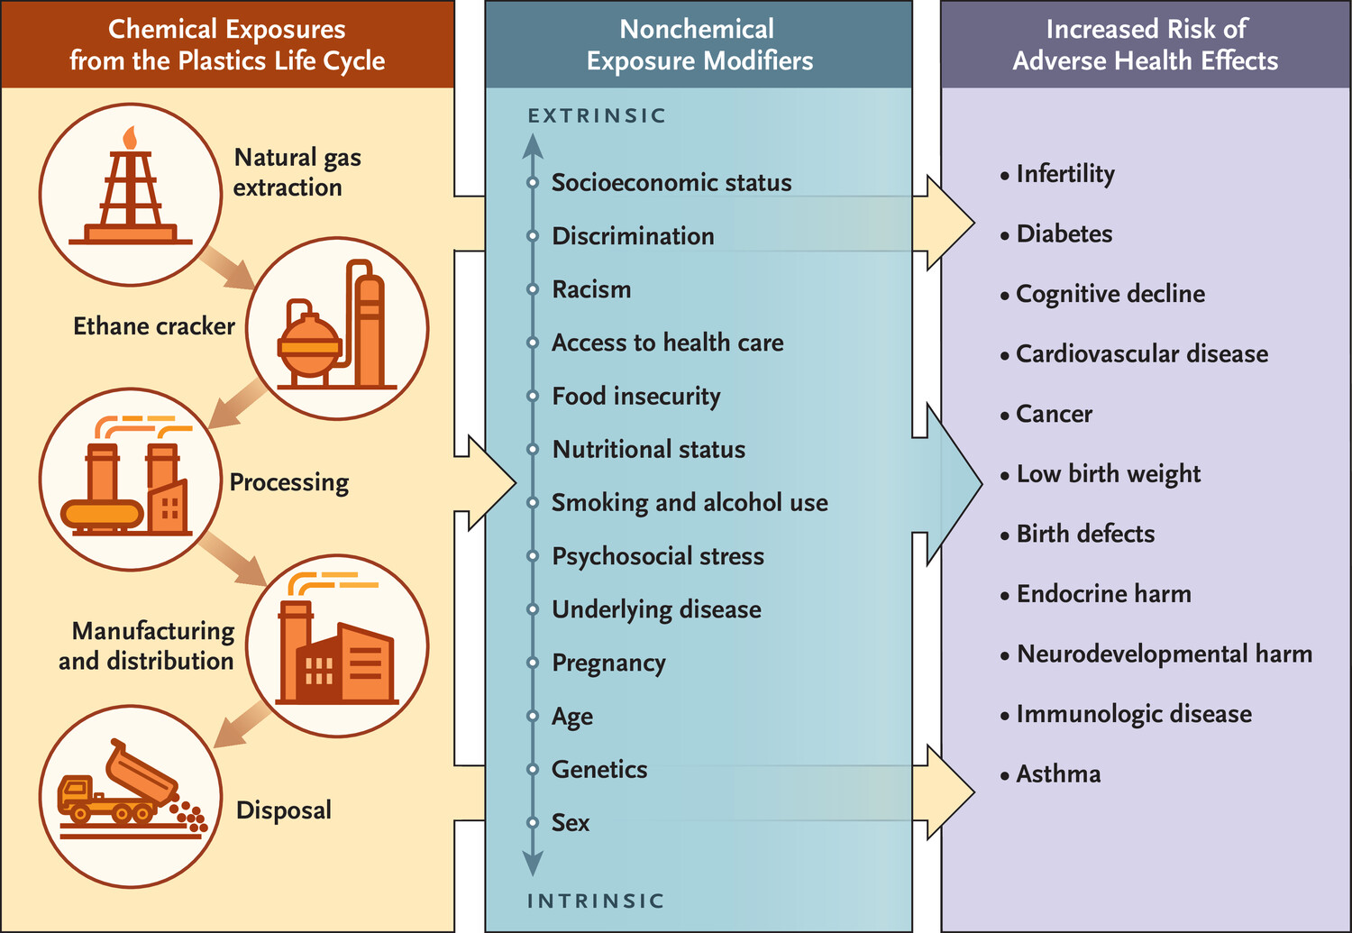
Consequently, experts believe that there is no risk-free level of exposure to these chemicals across the population.

Slide 12
Chemicals | Known/Likely | Who Says?
PFAS | Decreased fetal growth, dyslipidemia, decreased antibody response to vaccines in children and adults, | NAS*
Ortho-phthalates | Male reproductive toxicity (e.g. sperm effects, decreased anogenital distance^{28,43}), preterm birth⁴³, metabolic disorders (e.g., insulin resistance, diabetes) | NAS*, EPA Scientists Sys Rev
Flame retardants (e.g. PBDEs) | Impaired neurodevelopment | NAS*, Sys Rev
Bisphenols | Adverse effects on ovarian development and function⁷³, Female reproductive toxicity, Impaired neurodevelopment, Metabolic abnormalities; and Immune system abnormalities | EFSA*, CalEPA
Heavy Metals | Impaired neurodevelopment^{3,34}, male reproductive toxicity (e.g. semen quality, fertility affects), cancer, immunosuppression⁷⁵ | USEPA, CalEPA
Pesticides | Impaired neurodevelopment (e.g., lowered IQ,)³⁴, reduced sperm quality⁷⁷ | CalEPA, Sys Rev
Volatile Organic Compounds | Respiratory toxicity, lung cancer, nasopharyngeal cancer, leukemia, acute neurological harm, female reproductive toxicity, alternations to male reproductive system | USEPA*
* Bottom line evidence from Systematic Reviews

Slide 13










Solutions
People can reduce exposures to some chemicals through individual actions.
But most exposures cannot be eliminated due to lack of laws on data, disclosure and actions
Public policies essential to reduce fossil-fuel extraction, production, and use in petrochemicals to both decarbonize & detoxify

Slide 14
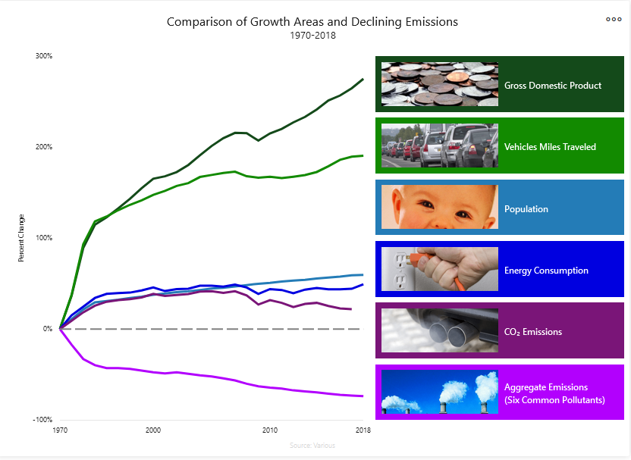
Opportunity to improve health
New rules to reduce fossil fuel use and toxic chemicals produce win-win
We can do it
New regulations based on this science lead to new systematic solutions decreasing exposures
  PFAS in drinking water
  EPA proposed to evaluate phthalates cumulative under TSCA
  Formaldehyde

Slide 15

Conclusions
Environmental chemical exposures are ubiquitous and adversely affect health inequitably.
We are all exposed and it can impact maternal and child health.
Fossil fuels contribute to climate change and petrochemicals, which increase disease. Reducing fossil fuels can reap a double benefit for climate change and improved health.
Science and healthcare providers alone cannot move systemic change. Engagement by scientists and health care providers and community is critical.
Systemic solutions through public policy is necessary to create lasting and fair solutions for all.
Help me be healthy!

Slide 16



Thank you!
Aileen Andrade
Alana D’Aleo
Allison Landowski
Allison Rozema
Amy Padula
Andrea Philips
Anne Sausser
Annemarie Charlesworth
Ariel Eastburn
Chanese Forte
Charlie Mead
Cheryl Godwin de Medina
Courtney Cooper
Thank you to our PRHE Faculty, Staff & Affiliates:
Cynthia Melgoza Canchola
Dana Goin
Dimitri Abrahamsson
Erin DeMicco
Garret Bland
Harim Lee
Jessica Trowbridge
Joshua Robinson
Kristin Shiplet
Laura Bettencourt
Lynn Harvey
Nadia Gaber
Nicholas Chartres
Maribel Juarez
Marya Zlatnick
Max Aung
Rachel Morello-Frosch
Susan Lamontagne
Swati Rayasam
Tali Felson
Thank you to our funders:
The Tides Foundation
The Marisla Foundation
The California Environmental Protection Agency
The Passport Foundation
The JPB Foundation
The National Institutes of Health
The Fine Fund
The Clarence E. Heller Charitable Foundation
National Institute for Environmental Health Sciences
EaRTH Center
Peggy Reynolds
Diana Laird
Susan Fisher
Jennifer Fung

Slide 17



For more information:
prhe.ucsf.edu
earth.ucsf.edu
Follow us
@UCSF_EaRTH
UCSF.EaRTH
Woodruff New England Journal of Medicine Volume 390 • Number 10 • March 7, 2024 Pages: 922-933

Slide 18
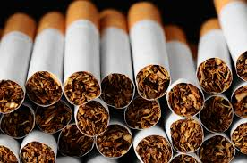





Industrial Epidemics
Estimated 58% of all premature deaths due to corporate produced risk factors including tobacco, fossil fuel pollution, alcohol, and processed/ultra-processed foods.
Moodie R, Stuckler D, Monteiro C et al. (2013Lancet 381, 670-679.
Gilmore et al. Lancet 2023 PMID: 36966782

Slide 19

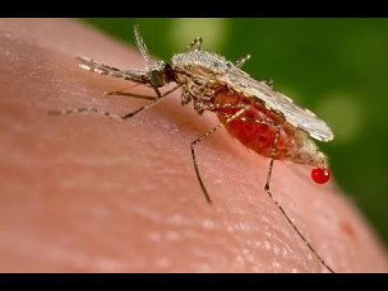
Industry as the 21st Century Vector of Disease
1990 Vector of Disease -> communicable Illness
2024 Vector of Disease -> noncommunicable/chronic illness
Disease Vector
  Living organism that carries and transmits an infectious pathogen to another living organism.
  Vectors are bloodsucking
Disease vector
  Corporate organism that transmits toxic environmental exposures
Increase in noncommunicable/chronic disease is a manifestation of a global economic system that prioritizes wealth creation over health creation.
Notes:
Mosquito – Ronald mcdonald/industry dropping something

