Slide 1
PFAS in Locally Caught Fish: A Potential Significant Source of Exposure and Threat to Health
Tasha Stoiber, PhD
Senior Scientist, EWG
CHE-Alaska
January 31, 2024

Slide 2
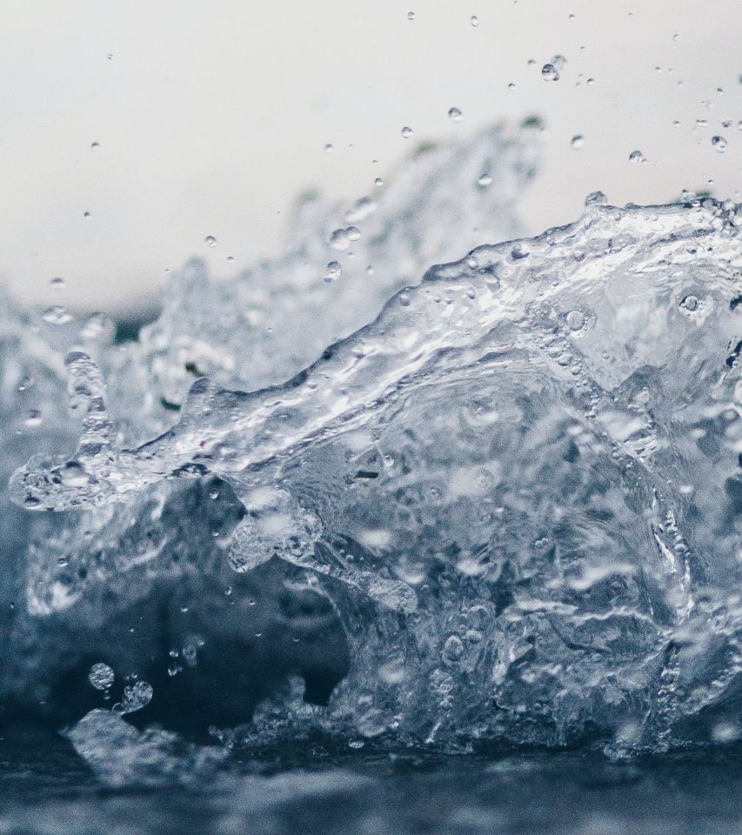
Outline
Recent research projects
Fish as a source of PFAS exposure
PFAS in wildlife

Slide 3
ewg.org

Slide 4
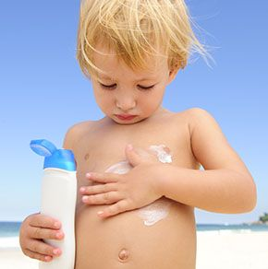
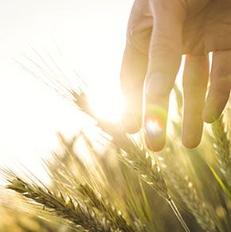
Inspiring Change: Activating the Public in the Absence of Regulatory Leadership

Slide 5
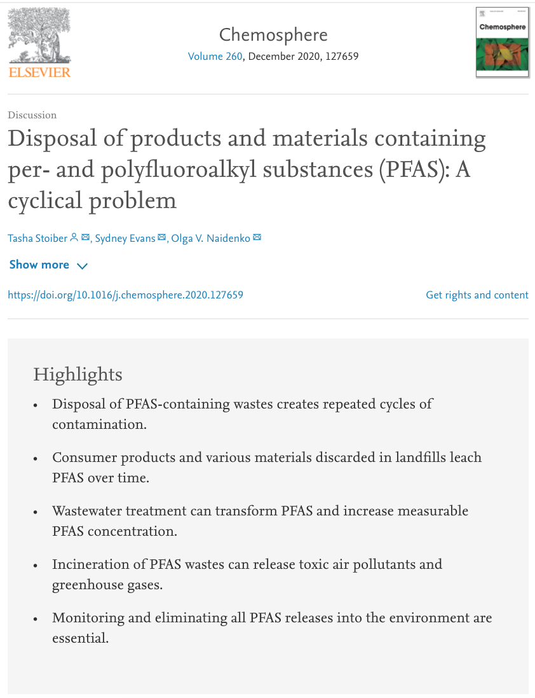
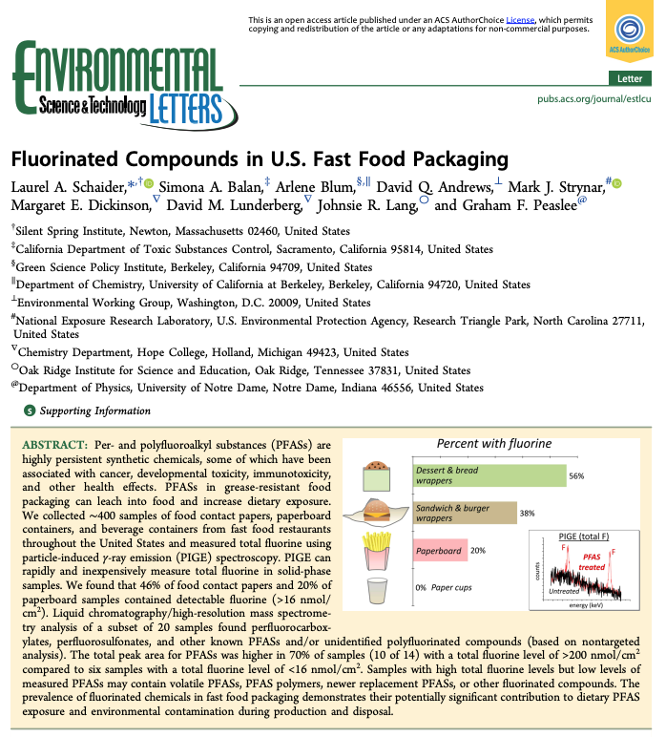
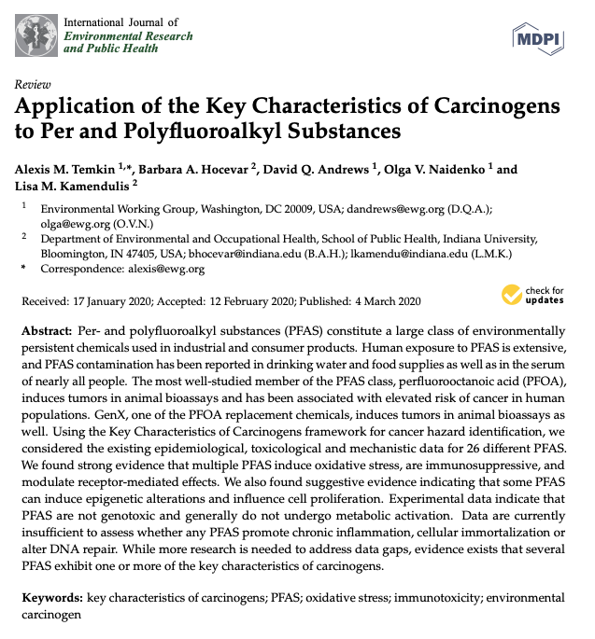
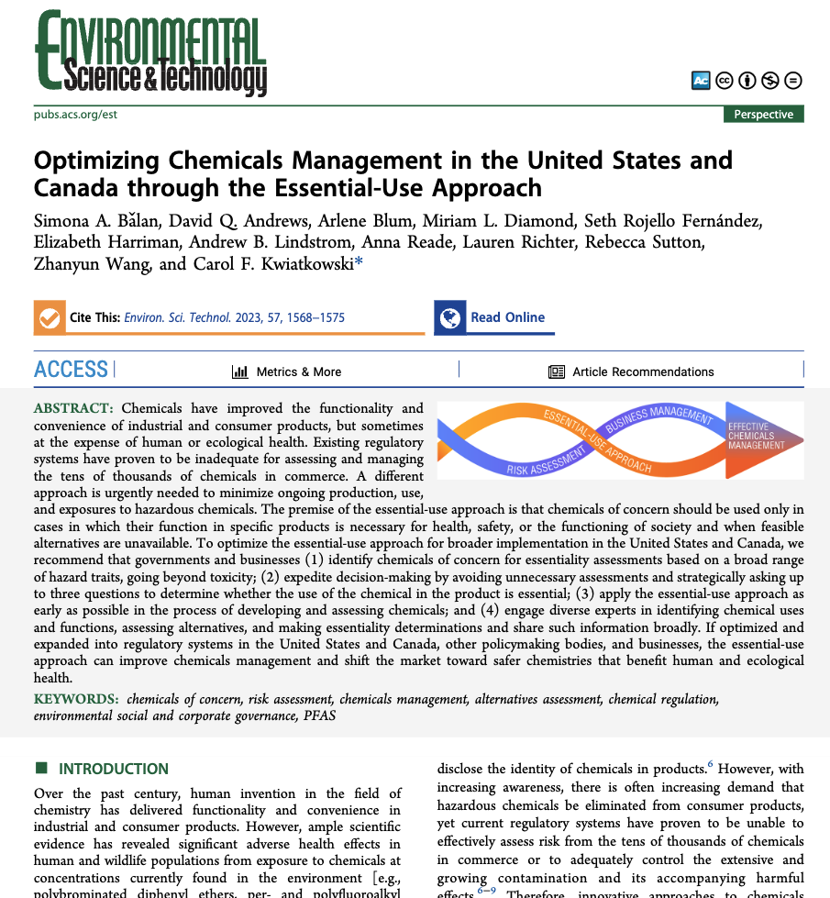
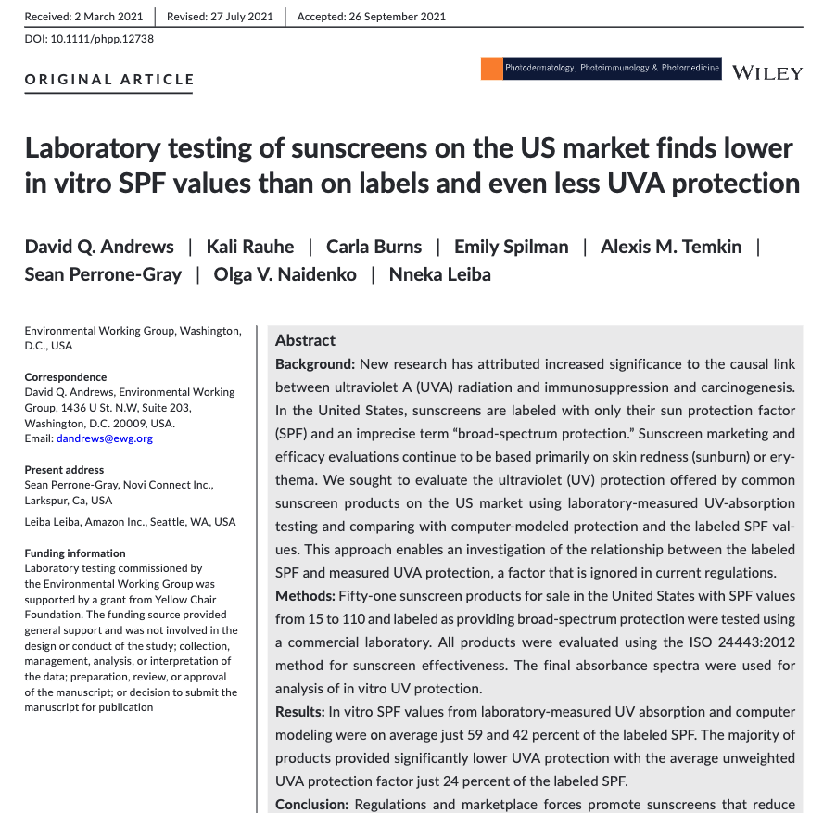
research publications

Slide 6
PFAS
Per- and polyfluoroalkyl substances

Slide 7
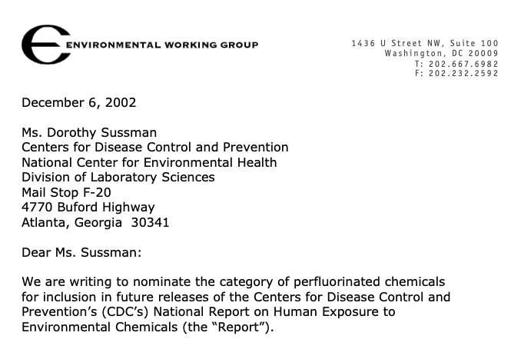
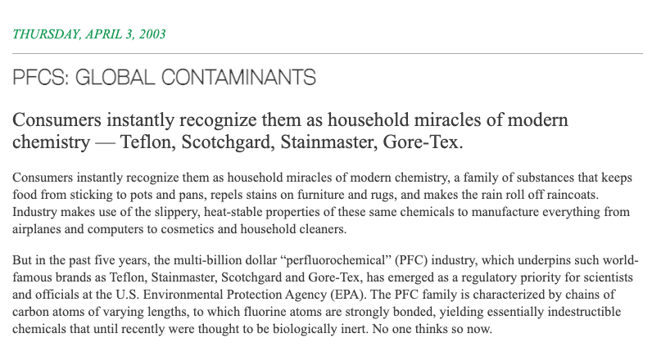

Slide 8
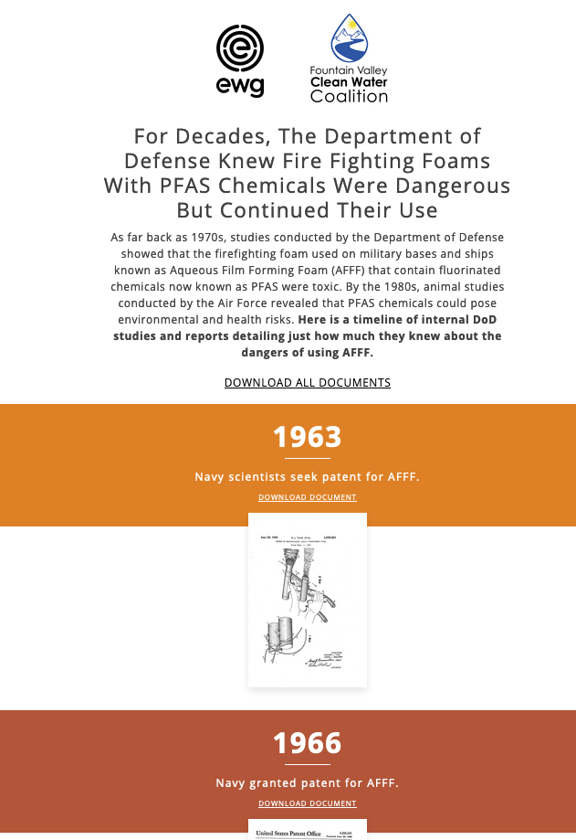
https://www.ewg.org/pfastimeline/
https://www.ewg.org/dodpfastimeline/

Slide 9
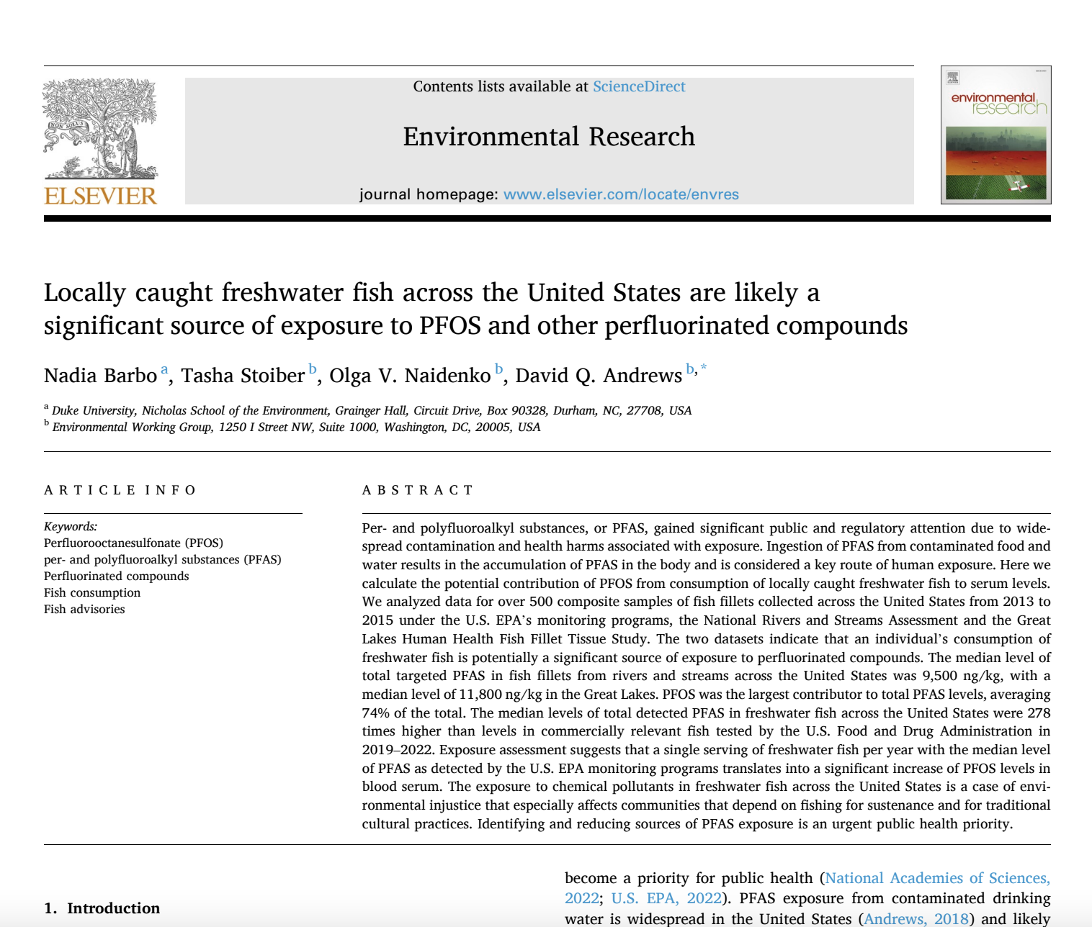
Recent projects (1) PFAS in fish
Highlights
PFAS are widely detected in freshwater fish across the United States.
U.S. EPA fish testing in 2013-2015 had a median PFAS concentration of 11,800 ng/kg.
Even infrequent freshwater fish consumption can increase serum PFOS levels.
One fish serving can be equivalent to drinking water for a month at 48 ppt PFOS.
Fish consumption advice regarding PFAS is inconsistent or absent in the U.S. states.
Over 100 news stories

Slide 10
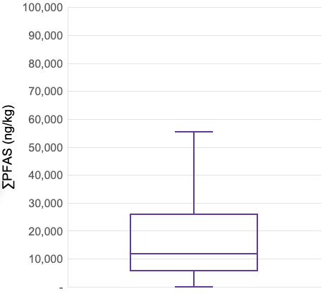
Infrequent consumption of freshwater fish can translate to significant PFOS exposure based on the median level in fish sampled by EPA between 2013 and 2015
PFAS levels in fish
(on average 74% PFOS)
Modeled PFOS serum increase from four meals a year
8
PFOS from 4 meals a year
4
NHANES median
2017-18
0

Slide 11
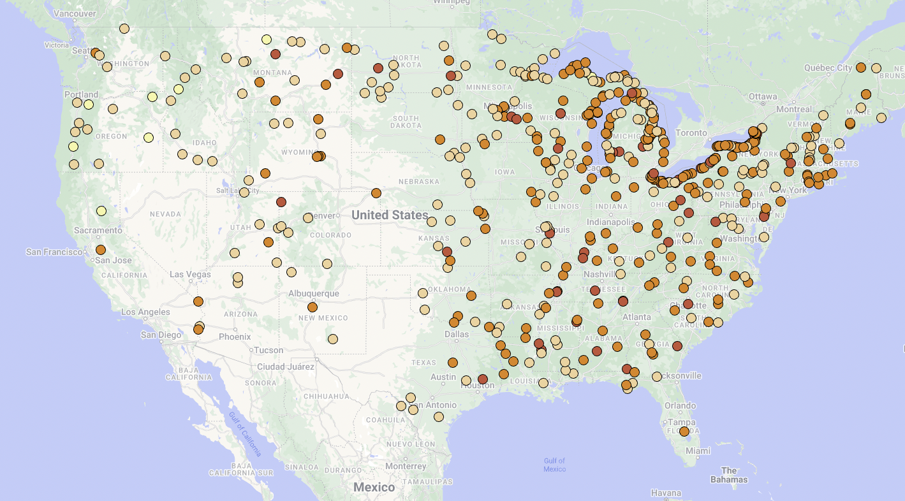
Total quantifiable PFAS in freshwater fish in the continental United States (2013-2015)
(50) > 50,000 ng/kg
(224) 10,001 - 50,000 ng/kg
(219) 1,001 - 10,000 ng/kg
(8) < 1000 ng/kg

Slide 12
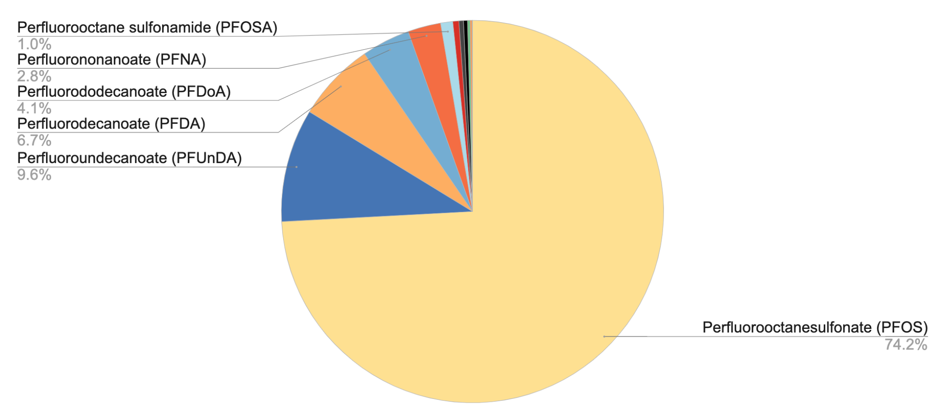
Average individual PFAS contribution to total PFAS across all fish samples with detections (n=500)
median total PFAS = 11,830 ng/kg
25th percentile = 5,685 ng/kg
75th percentile = 25,910 ng/kg

Slide 13
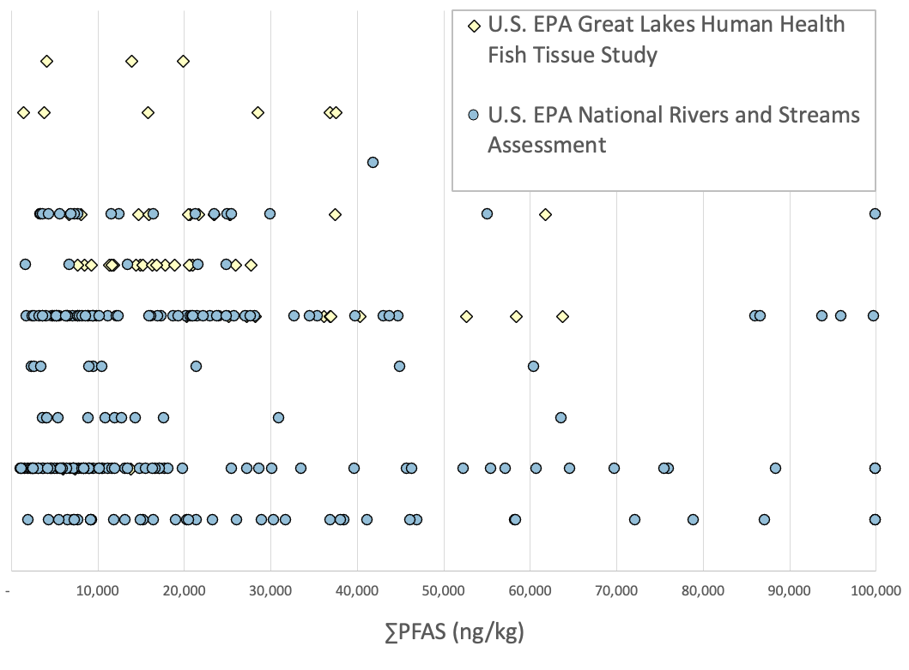
Sum of PFAS for commonly sampled fish species from the U.S. EPA National Rivers and Streams Assessment and the U.S. EPA Great Lakes Human Health Fish Tissue Study
Coho salmon (3)
Chinook salmon (6)
White catfish (1)
Walleye (31)
Yellow perch (24)
Smallmouth bass (77)
Flathead catfish (9)
Blue catfish (12)
Channel catfish (86)
Largemouth bass (37)

Slide 14
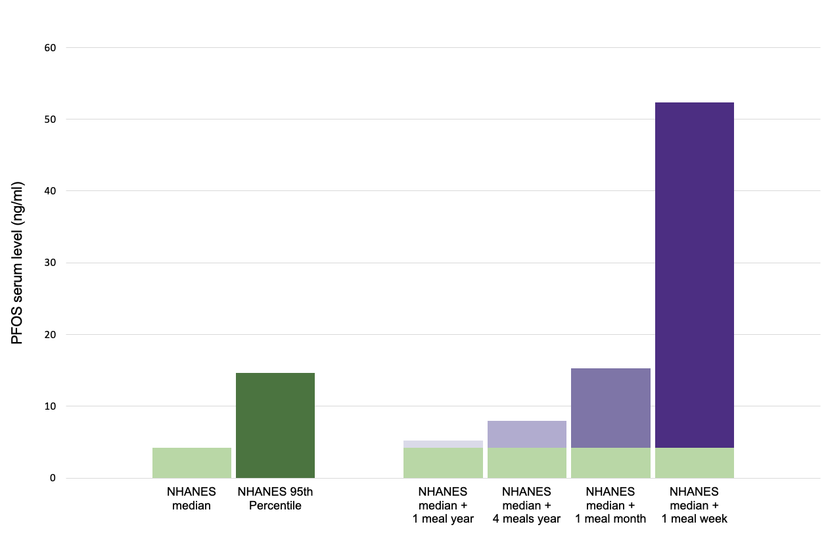
Expected increase in serum PFOS based on different freshwater fish consumption rates using a fish PFOS level of 8,415 ng/kg (median of 501 samples).

Slide 15
8,415
Equivalent to drinking water with 4 ppt PFOS for one year.

Slide 16
Communities that rely on fish are impacted the most
Study of anglers near Onondaga Lake in central New York state (northeastern United States): frequent consumers of freshwater fish →
median levels of PFOS and PFDA in their blood at 9.5 and 26.9 x the general U.S. median (Wattigney et al., 2022).
Great Lakes region: , licensed anglers and, specifically, anglers from the Burmese immigrant community had median PFOS levels that respectively ranged two and six times the U.S. population average (Liu et al., 2022).
Biomonitoring studies support the current study’s modeled results based median’s and estimated impacts on serum levels; model is conservative

Slide 17
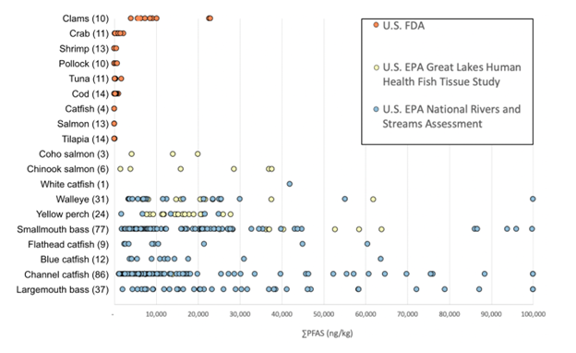
FDA sampling data: Grocery store fish levels were much lower
FDA datasets within the Total Diet Study sampling from 2019 to 2021 and a specific sampling of seafood conducted in 2022.

Slide 18
Lack of consistent national guidance with respect to how much fish can be safely eaten.
Most states guidelines (17) for PFAS in fish are specific to just PFOS
Most guidance based on 2016 EPA LHA reference dose
Some states also measure and have advisories for PFHxS, PFOA, PFNA, PFBA, PFBS, and HFPO
2019, Alaska: interim consumption recommendations in response to high PFOS, PFOA, and PFNA in two lakes (Kimberly and Polaris/Eielson area).
Alaska does not have specific consumption guidelines
Sampling by the Office of the Alaska State Veterinarian Fish Monitoring Program have had very low PFAS (https://dec.alaska.gov/eh/vet/fish-monitoring-program/ )

Slide 19
Summary
Nearly all fish in U.S. rivers and streams and the Great Lakes have detectable PFAS, primarily PFOS, in the μg/kg or ppb range
Fresh surface waters vulnerable
Fish can be a significant source of exposure
High frequency freshwater fish consumers are disproportionately affected
U.S. FDA testing shows that seafood purchased at grocery stores have significantly lower levels of PFAS
High levels of PFOS present in freshwater fish could impact serum levels is concerning; need national consumption advisories and an awareness program.
Data trends

Slide 20
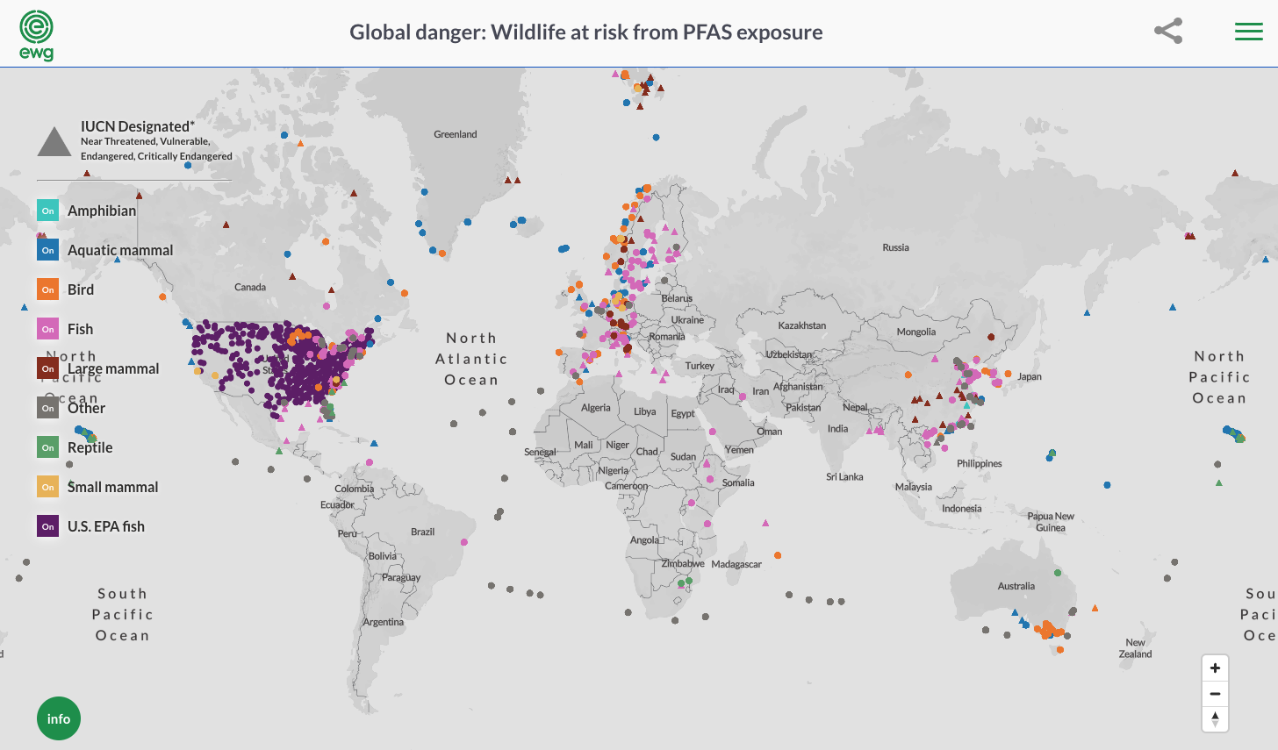
Recent project (2) PFAS in wildlife
Humans as sentinels for ‘forever chemical’ harm to wildlife health
update
global contamination of wildlife with PFAS map

Slide 21
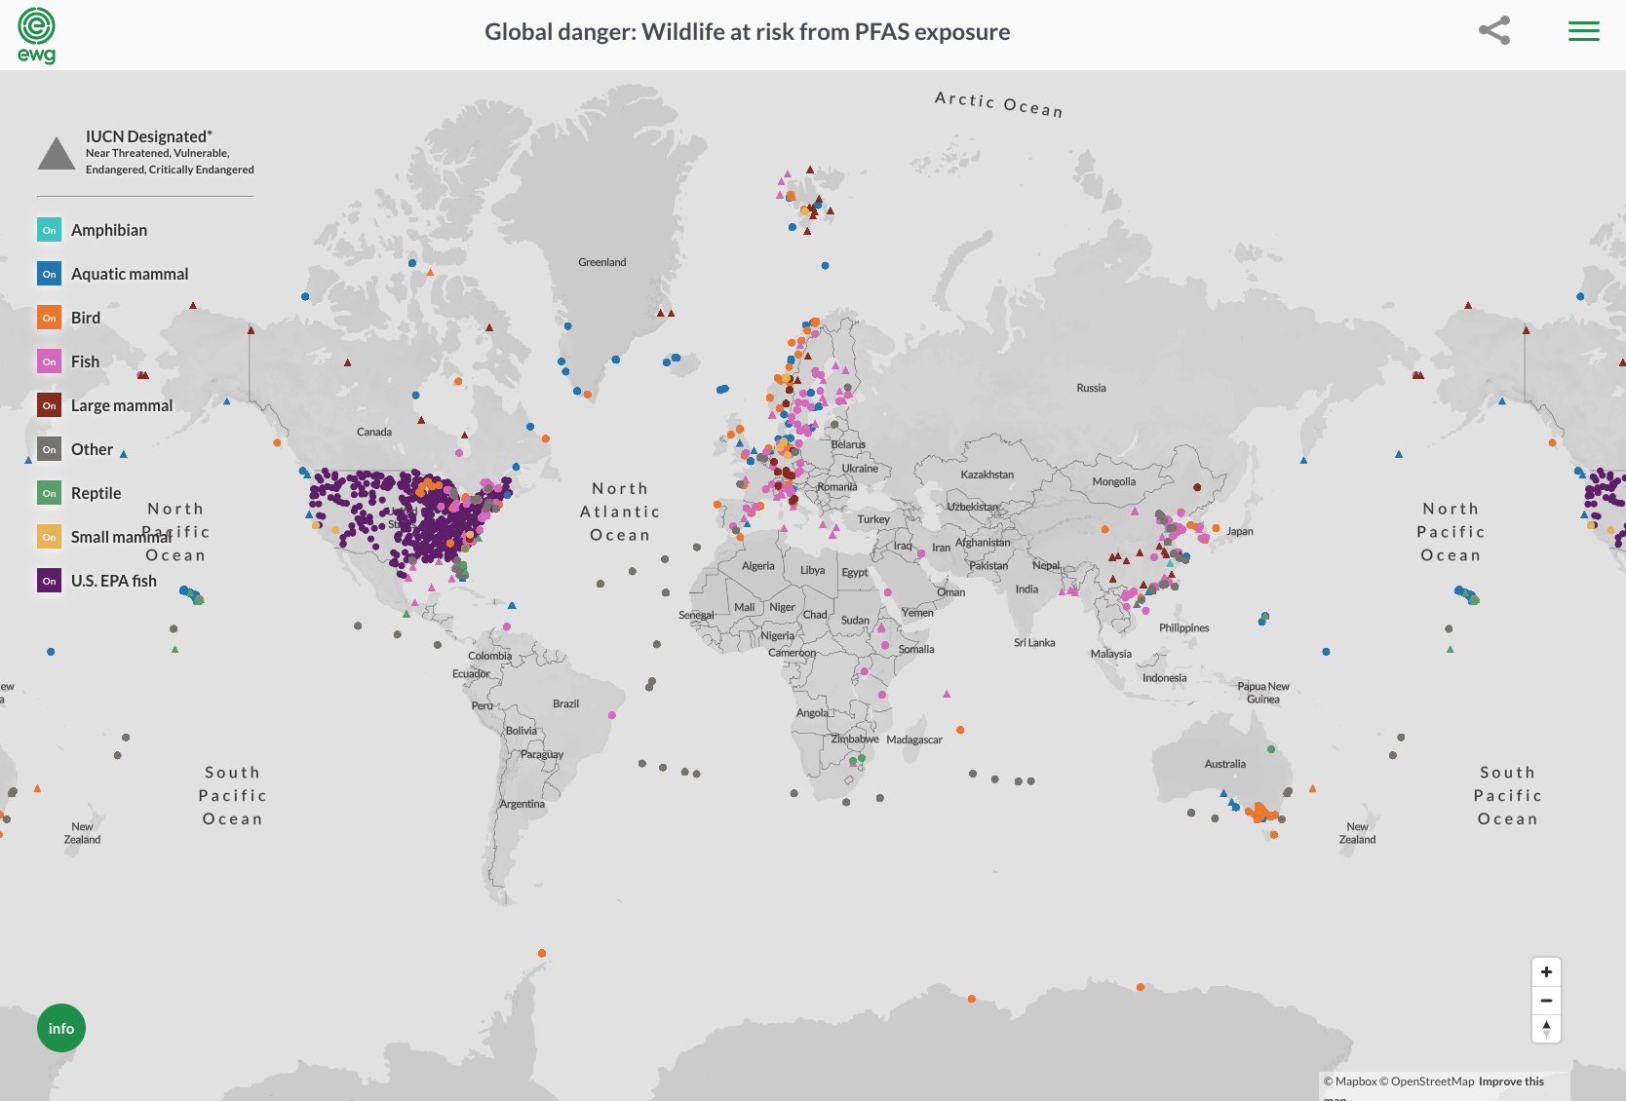
Updated map of global contamination of wildlife
over 250 peer-reviewed studies
over 625 species
120 different PFAS

Slide 22
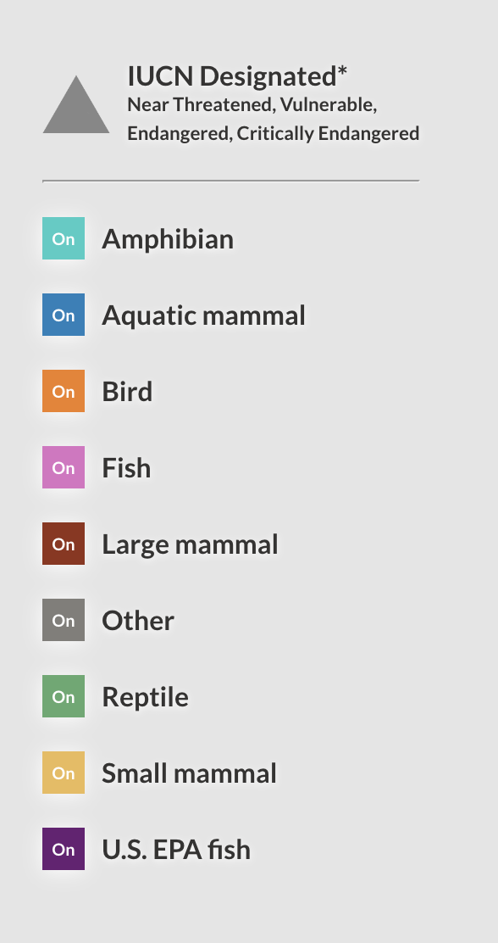
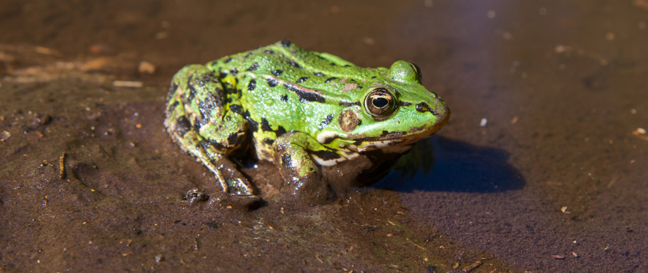
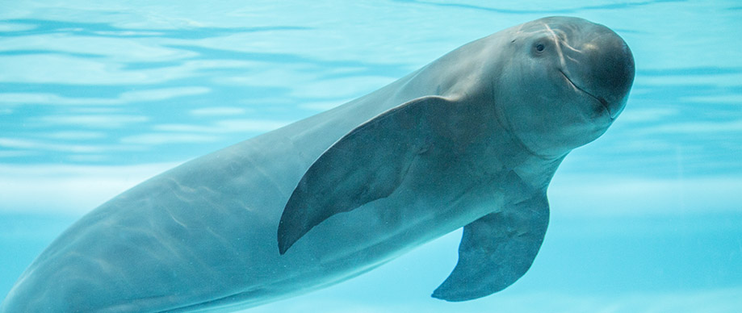
IUCN Critically Endangered (hawksbill turtle (Eretmochelys imbricata))
IUCN Endangered (Australian sea lion (Neophoca cinerea))
IUCN Endangered (finless porpoise (Neophocaena asiaeorientalis))
IUCN Near Threatened (black-spotted frog (Pelophylax nigromaculatus))
IUCN Vulnerable (sperm whale (Physeter macrocephalus))

Slide 23
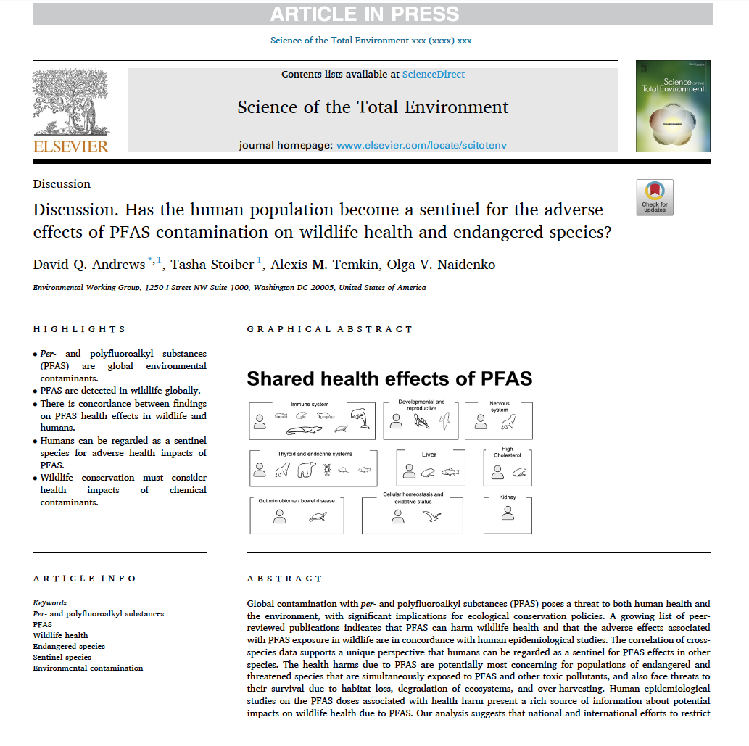
peer-reviewed discussion paper

Slide 24
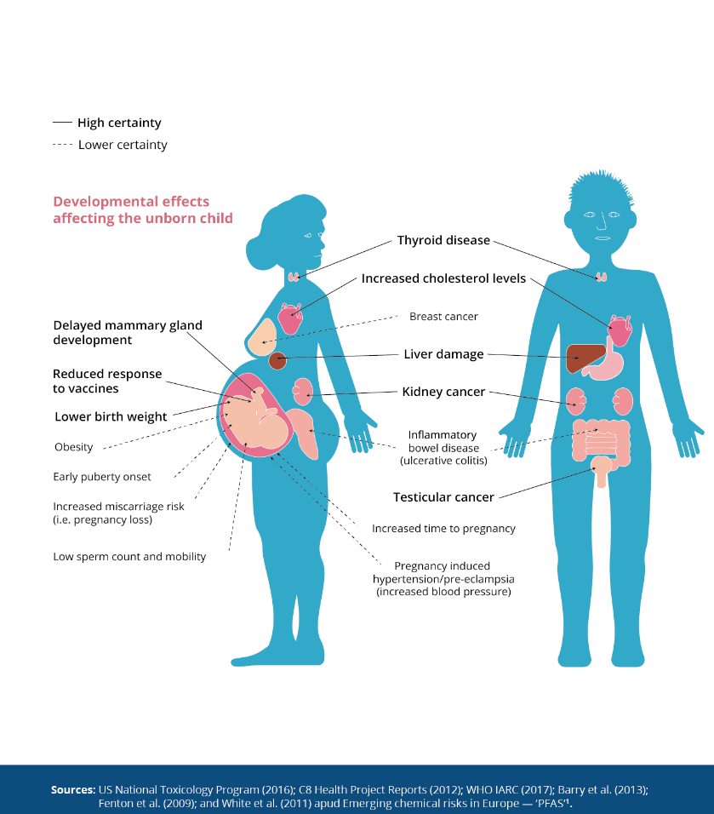

Slide 25
Shared health effects of PFAS
Immune system
Developmental and reproductive
Nervous system
Thyroid and endocrine systems
Liver
High Cholesterol
Cellular homeostasis and
oxidative status
Kidney
Gut microbiome / bowel disease

Slide 26
Summary
Human health and wildlife health are connected, what we know about human impacts can help protect animals
Face similar exposures
Similar health impacts
Widespread contamination in fish and wildlife = global scale
Phase out non-essential uses of PFAS
Controlling PFAS pollution and preventing future discharges are essential
Protect public health and freshwater fish economies
Protecting threatened and endangered species
Protection of wildlife populations from PFAS pollution has the potential to contribute to ecosystem stability and economic sustainability
More research for assessing and remediating PFAS contamination

Slide 27
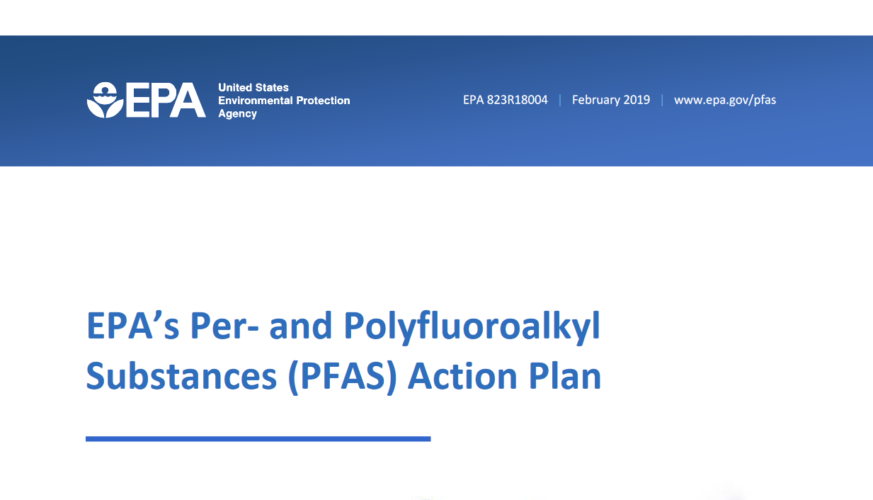
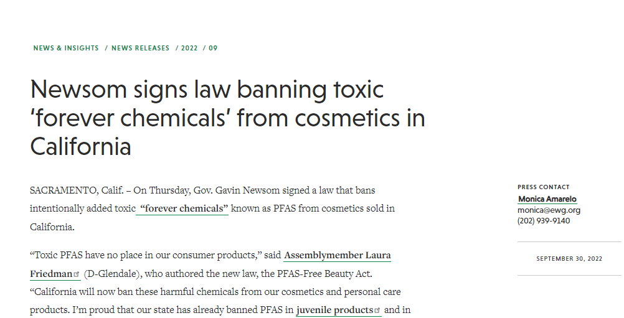

Slide 28
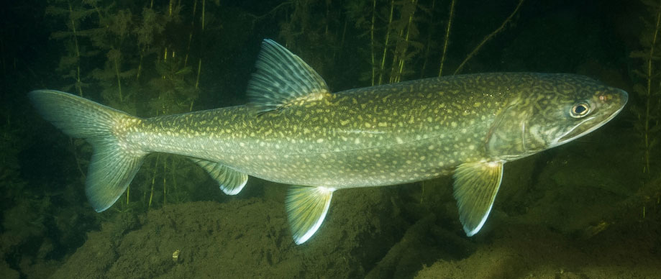
Thank you

