Slide 1
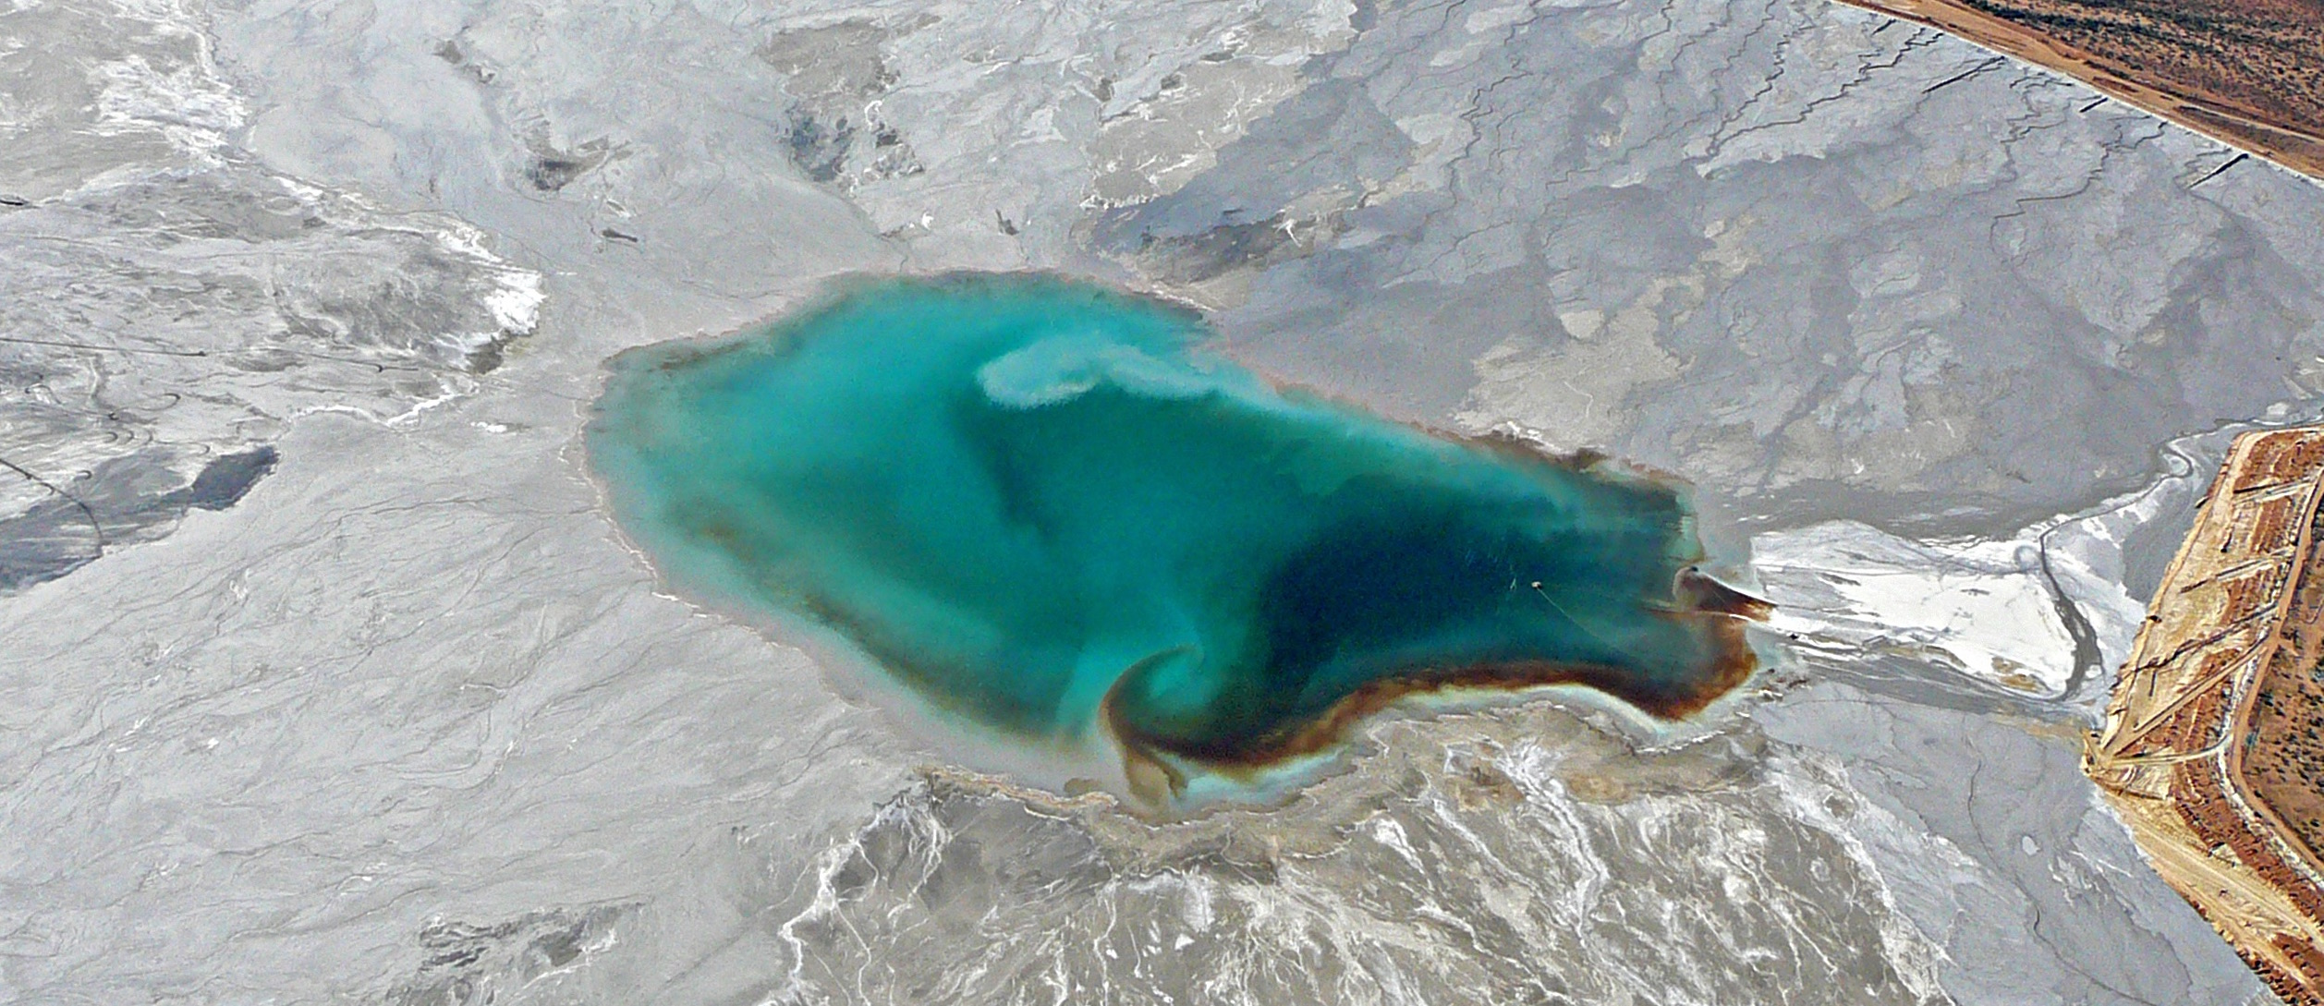
Making clean energy clean, Just & Equitable
Bonnie Gestring, Earthworks
bgestring@earthworksaction.org
https://earthworks.org/mcec
Protecting communities and the environment from the adverse impacts of mineral & energy development while promoting sustainable solutions
www.earthworks.org

Slide 2
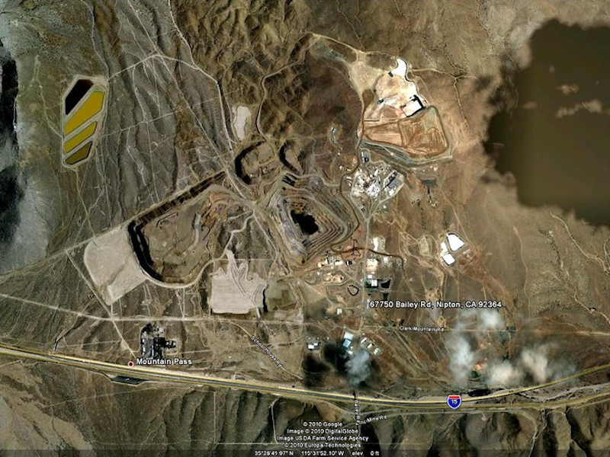
A CLEAN ENERGY FUTURE CANNOT BE BUILT ON DIRTY MINING
We must urgently transition to a 100% renewable energy economy to address the climate crisis
Renewable energy technologies, especially EV batteries, require a lot of minerals
We can’t replicate one form of harmful extraction with another
This must be be an opportunity moment – to not only transition to a low-carbon economy but also a more sustainable, just and low-impact materials economy that centers rights and equity
Protecting communities and the environment from the adverse impacts of mineral & energy development while promoting sustainable solutions
www.earthworks.org

Slide 3
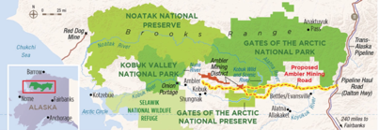
Alaska: Fueling Major Infrastructure projects
A 211-mile private industrial access road to access the Ambler Mining District.
2,900 streams and 11 major river crossings.
Transects migratory routes for three major caribou herds, including the Western Arctic Caribou Herd.
The mining companies have yet to demonstrate there are viable amounts of critical minerals in this region to justify the economics of the project, let alone the enormous impacts associated with the road.

Slide 4
Critical Mineral (USGS)
The Energy Act of 2020 defines a “critical mineral” as a non-fuel mineral or mineral material essential to the economic or national security of the U.S. and which has a supply chain vulnerable to disruption.
The US Geological Survey (USGS) is tasked with compiling the critical minerals list.

Slide 5
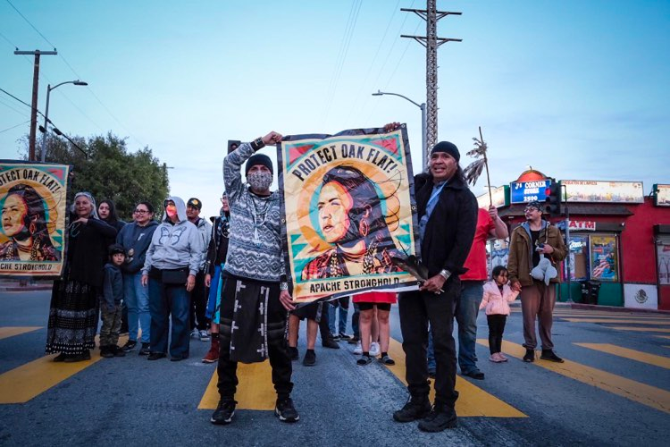
“transition” minerals
.
This narrative is used as justification to promote mining everywhere, regardless of impacts, and more importantly as justification for widespread efforts to reduce community and ecosystem protections.
We prefer to use the term “transition minerals” to describe this group of materials that are used in renewable energy technologies.
Apache Stronghold leaders call for protection of Oak Flat sacred site in Arizona from proposed Resolution Copper mine
Protecting communities and the environment from the adverse impacts of mineral & energy development while promoting sustainable solutions
www.earthworks.org

Slide 6
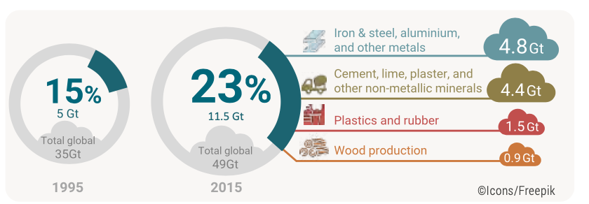
Why Mining Is A Threat to Communities, CLIMATE and Ecosystems
Carbon-intensive – metals mining and processing responsible for 10% of global carbon emissions
Mining operations are targeting increasingly lower grade deposits, which translates into much larger volumes of waste, and greater disturbance.
Graphics from UNEP International Resource Panel’s Resource Outlook (2019), and Resource Efficiency and Climate Change (2020) Factsheets
Protecting communities and the environment from the adverse impacts of mineral & energy development while promoting sustainable solutions
www.earthworks.org

Slide 7
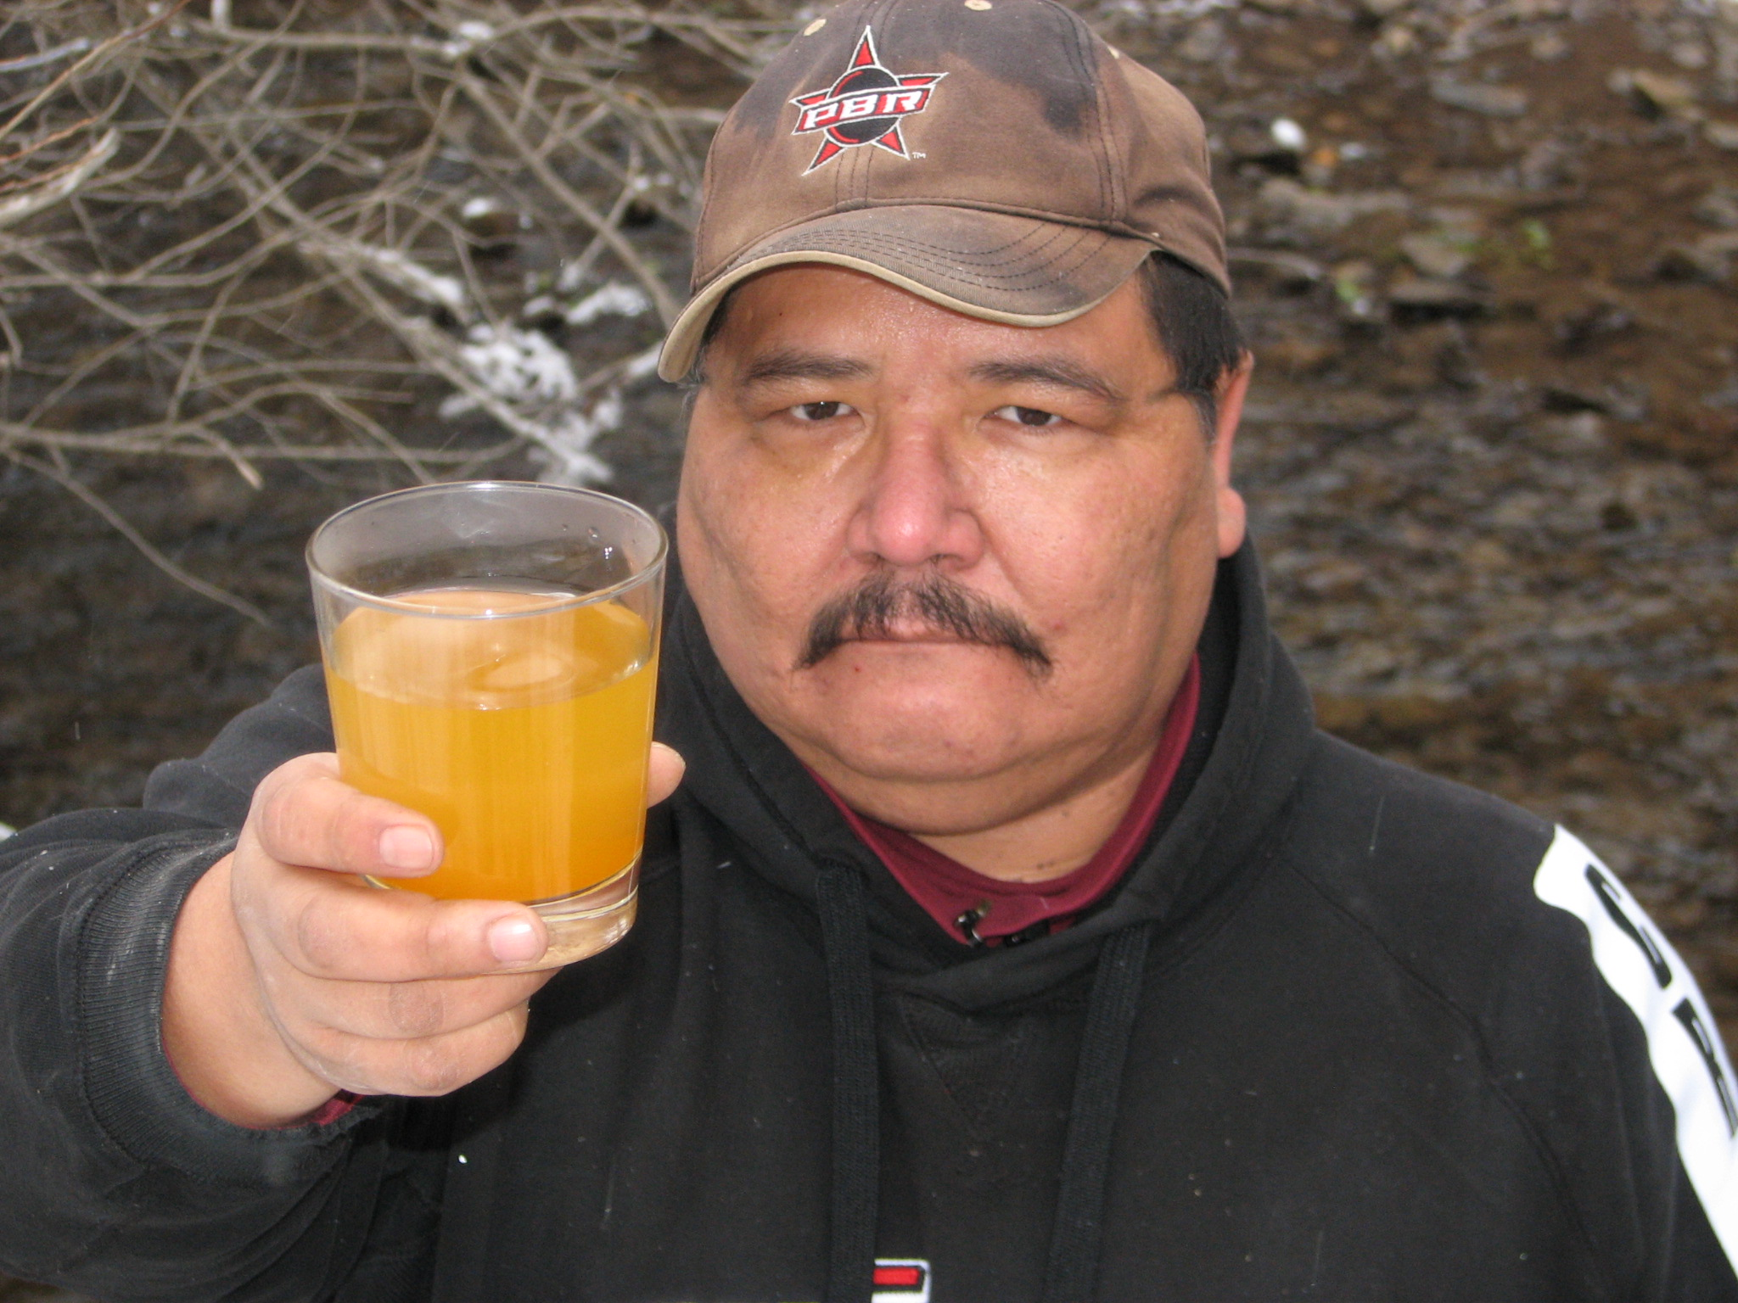
Why Mining is a Threat to Communities, Climate and Ecosystems, cont’d
Mining is the leading source of toxic releases in the U.S., according to the U.S. EPA.
Increasing number of mines generating water pollution in perpetuity from acid drainage or metals leaching. Freshwater pollution & use reduces water access and quality for ecosystems and communities/
The EPA has identified a backlog of $20‐54 billion in clean‐up costs from hardrock mining.

Slide 8
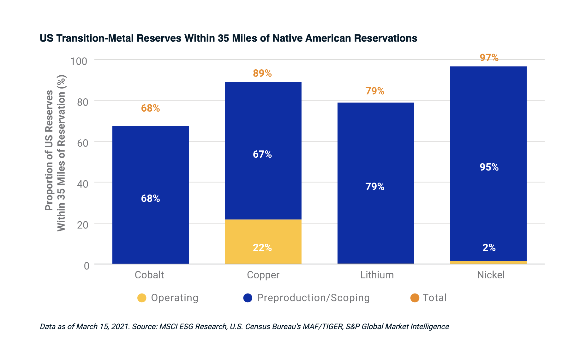
Disproportionate harm to Indigenous Peoples
Protecting communities and the environment from the adverse impacts of mineral & energy development while promoting sustainable solutions
www.earthworks.org
Notes:
The majority of U.S. reserves and operating and proposed cobalt, copper, lithium and nickel mines are located within 35 miles of Native American reservations.

Slide 9
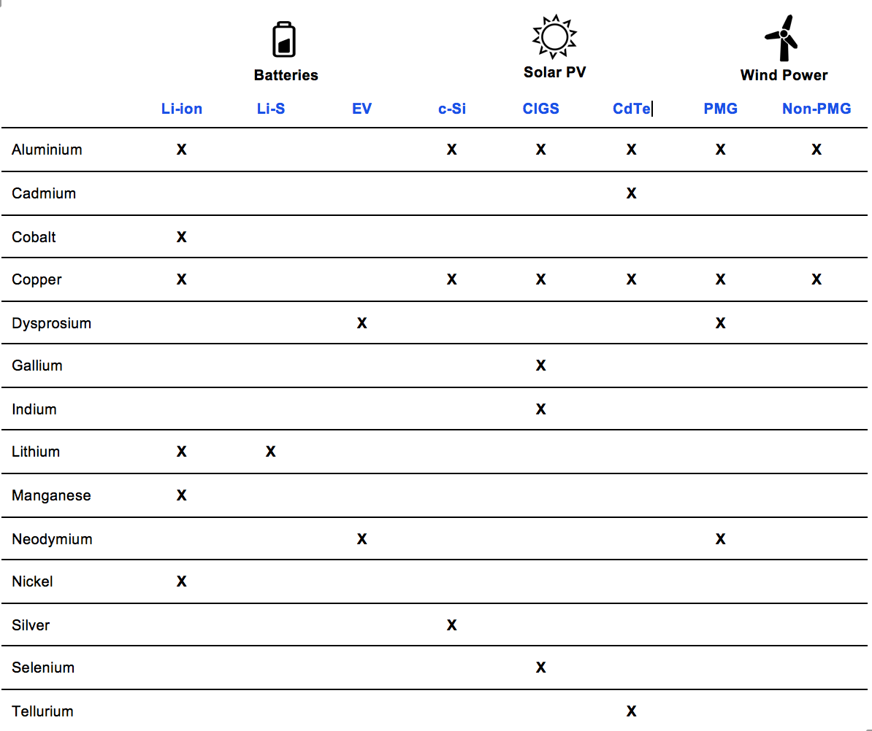
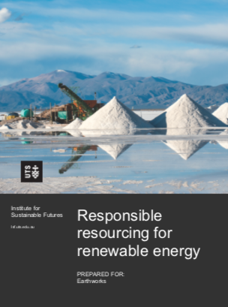
Key metals USED in clean energy technologies
Source: University of Technology, Sydney for Earthworks
Protecting communities and the environment from the adverse impacts of mineral & energy development while promoting sustainable solutions
www.earthworks.org

Slide 10
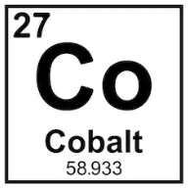
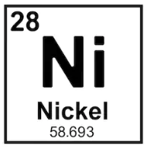
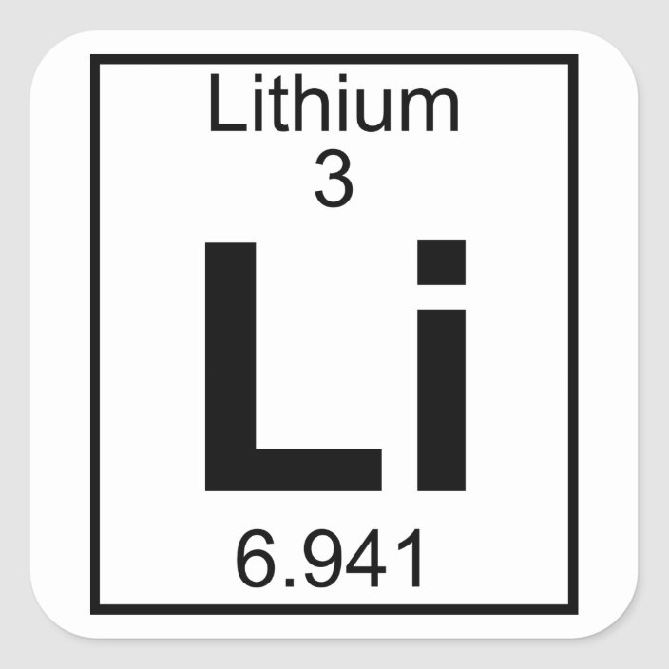
Key findings
Potential large increases in demand for metals that have only been mined in small amounts previously and where renewable energy, especially batteries, is a large share of demand (lithium, cobalt, rare earths)
Electric vehicles are the main driver of demand for key metals
A combination of technological shifts, recycling and increased efficiency has the most potential to reduce demand
Impact of private EVs vs. public transit – opportunity for a shift in transportation
Protecting communities and the environment from the adverse impacts of mineral & energy development while promoting sustainable solutions
www.earthworks.org

Slide 11
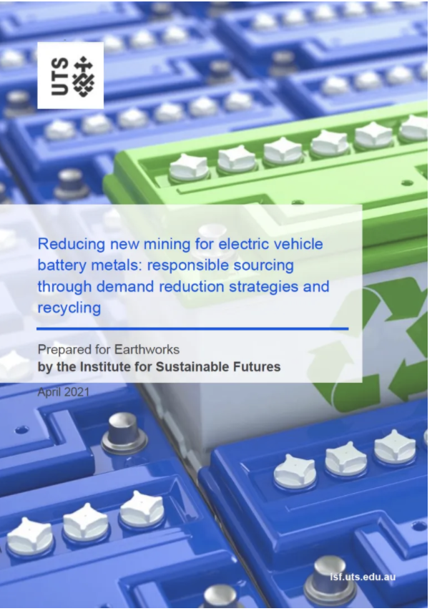
Reducing new mining for EV Battery Metals – 2021
Recycling has the potential to reduce primary demand compared to total demand in 2040, by approximately:
25% for lithium,
35% for cobalt and nickel and
55% for copper,
creating an opportunity to significantly reduce the demand for new mining.

Slide 12
PATHWAYS FORWARD: Recirculate
Policy interventions to boost recycling and minimize toxicity
Policy interventions to encourage metals recovery and recycling and remove barriers that tilt the balance in favour of new extraction e.g. new EU battery law
Mandating recycled content
Extending battery life and repurposing end-of-life batteries
Product take-back requirements, design for disassembly, and standardization of battery technologies
Prioritize health and safety for workers and communities to ensure no new sacrifice zones, ecosystem harm or injustices
R&D advances in battery technologies – changing chemistries and reducing mineral content
Protecting communities and the environment from the adverse impacts of mineral & energy development while promoting sustainable solutions
www.earthworks.org

Slide 13
PATHWAYS FORWARD: Recirculate
Reprocessing mine waste
Vast quantities of existing mine waste.
(e.g., Rare Earth Elements from the Berkeley Pit)

Slide 14
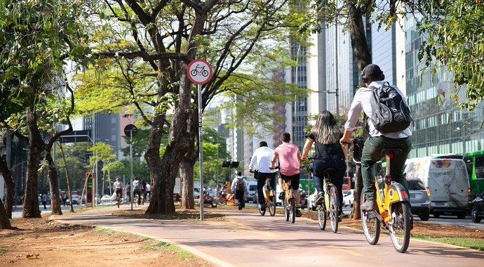
PATHWAYS FORWARD: Reduce Demand
Demand-side Shifts in Consumption and Transportation
Assumptions about minerals demand are not fixed – drastically lower depending on transportation model
Research from the Climate + Communities Project found that progressive policies, including best case recycling, and smaller car size, could reduce projected lithium demand by 92% in 2050.
Prioritize investments in electric-powered public transit and bike transit infrastructure
Equity in access to benefits of clean energy and transit
Protecting communities and the environment from the adverse impacts of mineral & energy development while promoting sustainable solutions
www.earthworks.org

Slide 15
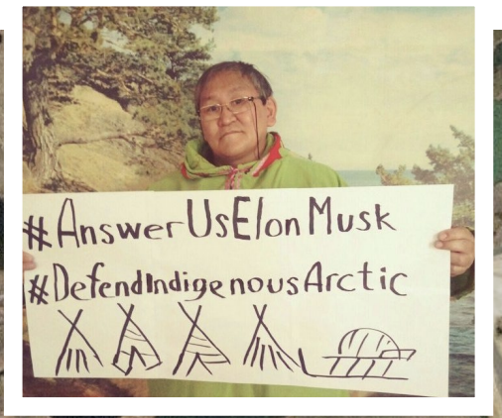
PATHWAYS FORWARD: reform the rules
High standards and binding rules to rein in mining impacts
The Clean Energy Minerals Reform Act, introduced by Rep Grijalva (D-AZ) and Sen. Heinrich (D-NM) in 2022, advances and continues to raise the urgency of comprehensive mining reform as a critical next step toward a more just, clean, and equitable minerals transition to renewable energy.
The President’s Interagency Working Group on Mining Reform released its recommendations, proposes changes to public lands mining rules or practices to provide more meaningful Tribal consultation and greater respect for treaty reserved rights.
Center Free, Prior & Informed Consent of Indigenous Peoples (FPIC) as enshrined in UN Declaration on the Rights of Indigenous Peoples.
Protecting communities and the environment from the adverse impacts of mineral & energy development while promoting sustainable solutions
www.earthworks.org

Slide 16
Thank you!
Bonnie Gestring, Earthworks
https://earthworks.org/mcec
Protecting communities and the environment from the adverse impacts of mineral & energy development while promoting sustainable solutions
www.earthworks.org

