Slide 1
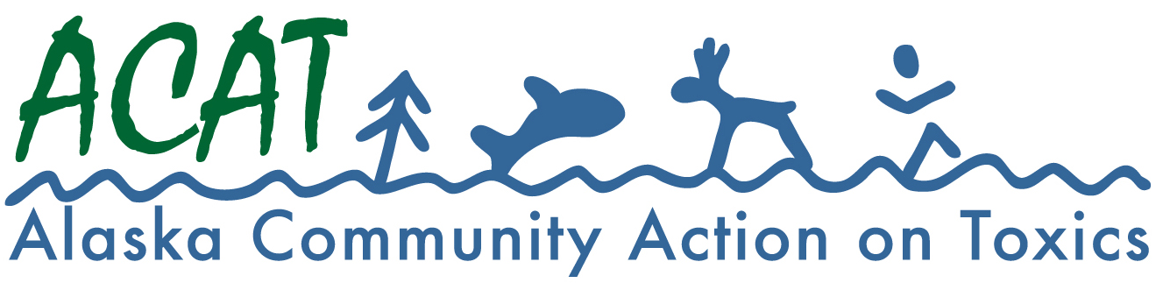
Environmental and Health Threats Associated with PFAS and Opportunities to Prevent Further Harm
Dr. Samarys Seguinot-Medina (Sama)
Environmental Health Director
Alaska Community Action on Toxics (ACAT)
Presenting on behalf of Pamela K. Miller, Executive Director of ACAT
January 31st, 2024

Slide 2
About PFAS
PFAS were developed beginning in the 1940s and today the class of chemicals includes more than 12,000 compounds. PFAS were developed for their useful commercial and industrial properties: they resist heat, oil and water. These same attributes make PFAS extremely resistant to environmental degradation, earning them the name “forever chemicals.”
PFAS bioaccumulate and are toxic. PFAS are used in many consumer products, including nonstick cookware, food packaging, waterproof clothing and gear, stain-resistant furniture and carpeting, and personal care products.
PFAS are also found in a type of firefighting agent known as aqueous film forming foam (AFFF) used at airports, military installations, oil and gas facilities, fire training centers and other locations to extinguish petroleum and other flammable liquid (known as Class B) fires.

Slide 3
In Alaska…
Unlike many other states with PFAS-related fish consumption advisories, Alaska lacks regulations and health guidelines for PFAS contamination.
Several lakes in Alaska have fish consumption warnings due to PFAS contamination from firefighting foam.
PFAS exposure is a significant issue in Alaska also due to atmospheric transport and ocean currents carrying pollutants from all over the planet to the Arctic.

Slide 4
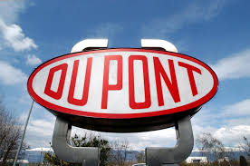
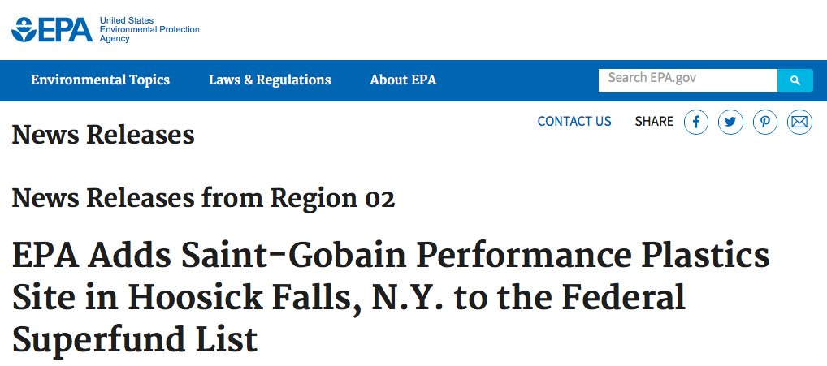
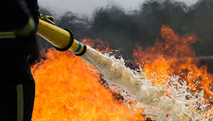
Sources of Drinking Water Contamination
AFFF (aqueous film-forming foam) for fuel fires
Production facilities
Waste disposal sites
Wastewater
Other industries

Slide 5
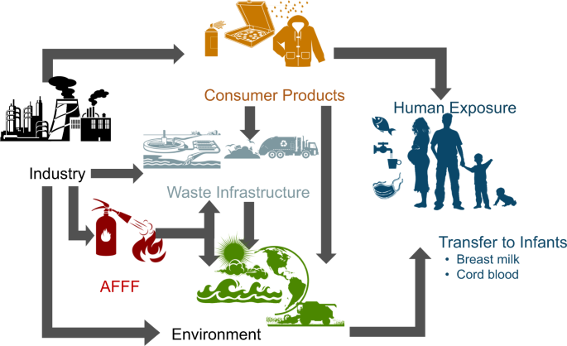
How are we exposed to PFAS?
Contaminated drinking water
Food
Direct contact with products
Household dust
Air
Cord blood
Breast milk
Infant formula

Slide 6
Health effects from PFAS exposure
PFAS are associated with human health harms that include:
cancer
heart disease
birth defects
liver disease
decreased immunity
Rural and Indigenous communities, relying on freshwater fish as part of their traditional diet and culture, may be at higher risk from these serious health threats.

Slide 7
Fenton SE et al. 2021. PFAS Toxicity and Human Health Review. Environ Toxicol Chem 40(3):606-630. doi:10.1002/etc.4890

Slide 8
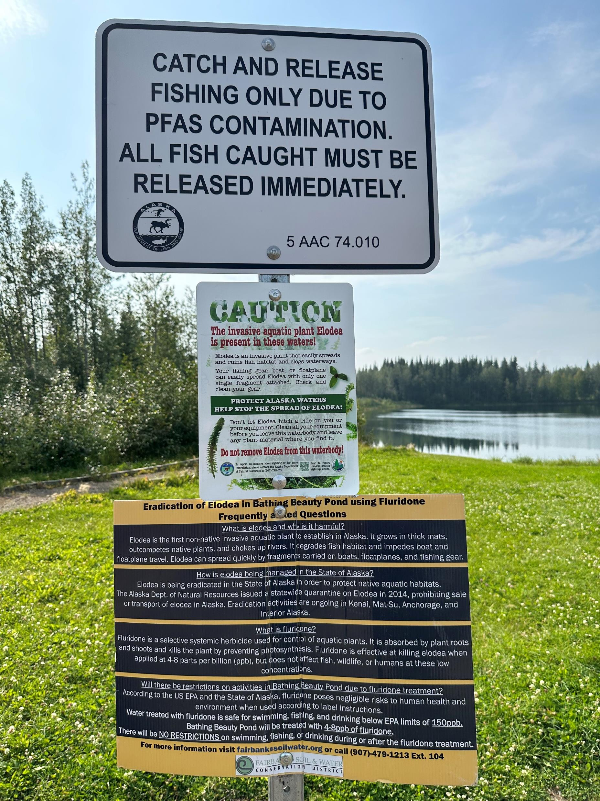
Environmental Injustice
PFAS contamination in freshwater fish, is an environmental justice issue for communities that depend on locally caught fish for sustenance and traditional cultural practices.

Slide 9
Threats to Drinking Water and Public Health in Alaska – The Scope of the PFAS Problem, Consequences of Regulatory Inaction, and Recommendations
Notes:
The purpose of this report is to aid Alaskans as well as state and federal policymakers in making informed decisions to protect current and future generations from continued exposure to the PFAS class of chemicals. The information presented here was obtained through a review of the peer-reviewed scientific literature, hundreds of documents obtained through public records requests, and interviews with scientists and agency personnel.

Slide 10
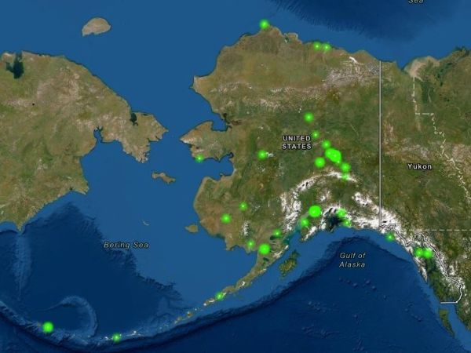
PFAS in Alaska
In 2019, PFAS had been discovered at over 100 individual sites (mostly “AFFF source areas”) in nearly 30 locations.
Currently, there are 469 sites in Alaska where PFAS contamination has been identified in soil and water according to the ADEC.
Communities throughout Alaska have unsafe levels of PFAS in drinking water.
Lakes closed to fishing include Kimberly, Bear, Moose, and Polaris Lakes; Bathing Beauty Pond, Piledriver Slough, Moose Creek.

Slide 11
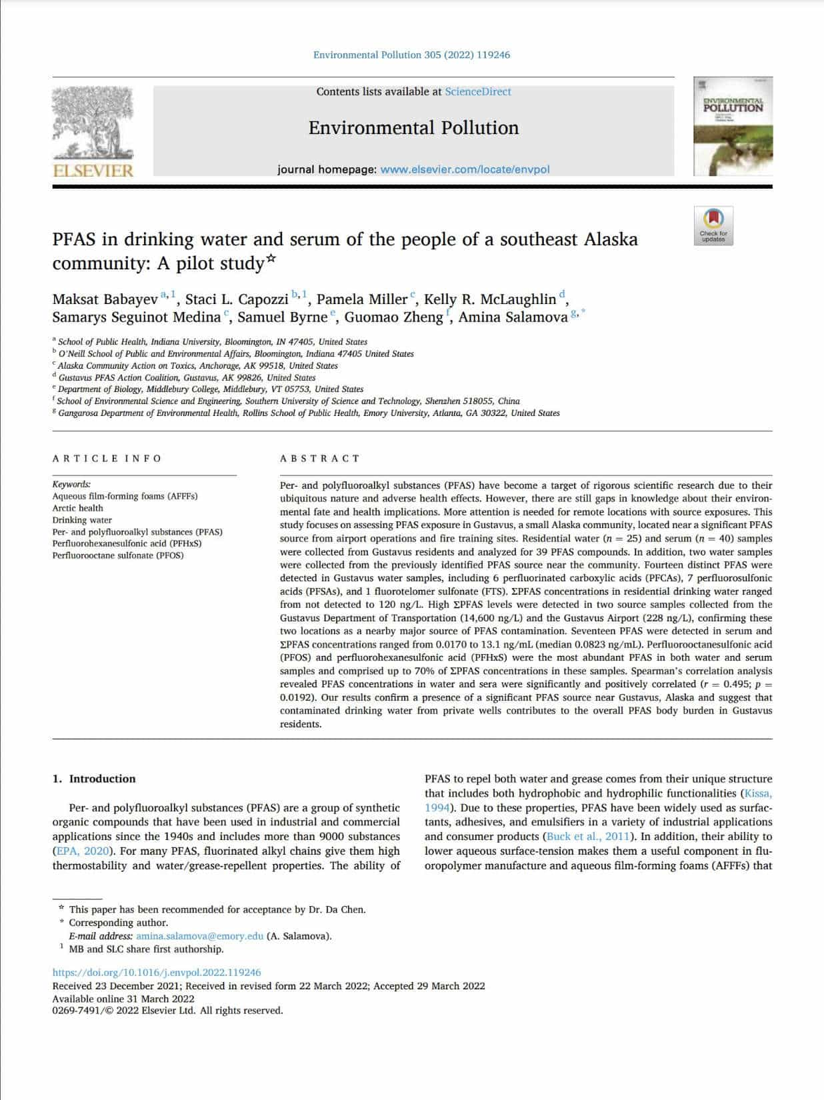
PFAS in drinking water and serum of the people of a southeast Alaska community
Published in the scientific journal Environmental Pollution: https://pubmed.ncbi.nlm.nih.gov/35367506/
Collaborative research of ACAT, Gustavus PFAS Action Coalition, and Indiana University
Key findings:
Our study found fourteen distinct PFAS in Gustavus water samples and seventeen different PFAS in serum.
Perfluorooctanesulfonic acid (PFOS) and perfluorohexanesulfonic acid (PFHxS) were the most abundant PFAS in both water and serum samples.
We also found that contaminated drinking water from private wells contributes to the overall PFAS body burden in Gustavus residents.

Slide 12
Alaska Community Water Quality Report: PFAS Contamination of Municipality of Anchorage and Fairbanks North Star Borough Waters

Slide 13
PFAS Contamination in Alaska
Alaska Community Action on Toxics (ACAT) conducted independent water quality testing in 2022 that showed PFAS (per- and polyfluoroalkyl substances) contamination in Anchorage lakes as well as in Ship Creek. These results show contamination in lakes used for swimming and fishing.
The results also show contamination in Ship Creek downstream from Joint Base Elmendorf and Fort Richardson (JBER), an important urban ecosystem for fish, wildlife, as well as fishing.
The samples from 2021 and 2022 revealed the presence of toxic PFAS chemicals in all the water bodies we tested in both Anchorage and the Fairbanks North Star Borough.
These data emphasize the need for urgent action to protect public health as well as wildlife. The data concerning PFAS in our local lakes are of concern to environmental and public health.
The information is a public right-to-know issue.

Slide 14
Results
Our sampling analyses revealed PFAS levels in Anchorage lakes ranging from 10.2 parts per trillion (ppt) (Sundi Lake) to 952.2 ppt (Lake Spenard).
In the Fairbanks North Star Borough, levels ranged from 2.8 ppt (Ballaine Lake) to 179.4 ppt PFAS (Airport Lake).
Concentrations in Ship Creek ranged from 4.3 ppt to 32 ppt. Levels of PFAS in Anchorage lakes and Ship Creek are similar to those that triggered fish consumption advisories by the Alaska Department of Fish and Game for certain lakes in the Fairbanks North Star Borough.
Levels of PFAS in fish can be several orders of magnitude higher than in the ambient waters because many PFAS are strongly bioaccumulative.

Slide 15
PFAS in Anchorage Waters
Methods: Sample analyses were performed in the Cyclopure laboratory using LC-MS/MS. Measurements were quantified to 1-2 ppt for all PFAS compounds. The laboratory uses isotope dilution methods for the measurement of PFAS on LC-MS/MS, with validated extraction and recovery criteria for 55 PFAS analytes. The analysis of drinking water samples is validated to the requirements of EPA Methods 537 and 533.
EPA proposed maximum contaminant levels for drinking water (March 2023):
PFOA 4 parts per trillion (ppt)
PFOS 4 ppt
PFNA Hazard index of 1.0 PFHxS
PFBS
HFPO-DA (GenX chemicals)

Slide 16
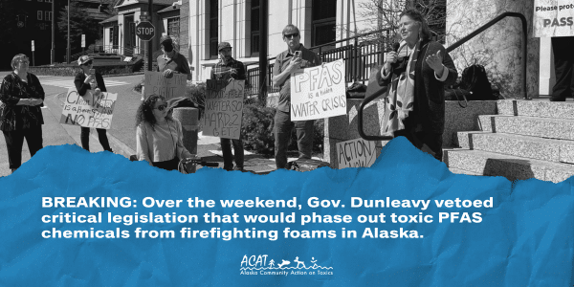
The Alaska Legislature working in a bipartisan manner passed House Bill 51 in May 2023, legislation that would have been a significant step toward preventing further water contamination from dangerous per- and polyfluoroalkyl (PFAS) chemicals across the state.
58 of 60 members of the Alaska House and Senate worked across party lines to pass this bill, the governor’s veto pen brought progress on PFAS to an abrupt halt.
We call on legislators to use their power to override the governor’s veto of HB 51 and to continue to work toward passing comprehensive legislation to address the PFAS problem in our state and to protect the health of all.
We support the passage of Senate Bill 67 (unanimously passed by the Senate and transmitted to the House) and strongly advocate that SB 67 be further strengthened to include the following:
Notes:
“…a person may not use a firefighting substance that contains a PFAS substance in the state unless the use is permitted under (b) of this section or required by federal law…”
https://www.akleg.gov/basis/Bill/Detail/33?Root=SB67
SB 67 sponsors: Senators Kiehl, Gray-Jackson, Dunbar, Giessel, Claman, Kawasaki, Tobin, Stevens, Wielechowski
Passed the Senate unanimously on May 8, 2023
“…a person may not use a firefighting substance that contains a PFAS substance in the state unless the use is permitted under (b) of this section or required by federal law…”
Effective date: January 1, 2024
HB 51, Short title: PFAS Use, Disposal; Refrigerants
Sponsors/Co-sponsors: Representatives Wright, Mears, Ruffridge, Schrage, Josephson, Galvin; Senators Kiehl, Tobin, Kawasaki, Wielechowski, Dunbar, Gray-Jackson, Olson, Bishop, Claman
Passed the House 38 to 2 (nays Carpenter and Eastman) on 5/17/23
Vetoed by Gov. Dunleavy on 8/26/23

Slide 17
We asked the Alaska State Legislature to enact legislation this session to protect our waters and public health, including provisions that:
• Create health protective, enforceable drinking water standards to reflect current science.
• Provisions to phase out PFAS in fire-fighting foam should be modeled after laws passed in WA, CO, and CA. No exemption should be allowed for the oil and gas industry, as safe and economical alternatives are available and in use.
• Provide safe drinking water sources for affected communities.
• Pass comprehensive legislation to phase out uses of PFAS including food packaging, textiles, cosmetics and other non-essential uses—model after states such as MN and ME.
• No incineration of PFAS wastes should be permitted. Incineration is a false solution, does not destroy PFAS, and results in air contamination and wider exposures to communities that are already overburdened with pollution sources. NY and IL have banned incineration.
• Include provisions for comprehensive monitoring of surface and groundwaters, fish, wildlife, and garden produce.
• Minnesota passed a bill in May 2023, “Amara’s Law,” that will ban the sale of non-essential uses of PFAS-containing products from 13 categories, including menstrual products, cookware, children’s goods, and firefighting foam.
• Place financial responsibility on large industries that are directly or indirectly linked with PFAS pollution (e.g., PFAS manufacturers) to cover costs of clean up, assistance for communities and water utilities affected by PFAS contamination.

Slide 18
Statement
“Alaska is lagging behind other states that are leading the way in enacting legislation to protect the health of their residents and prevent further harm from exposure to PFAS,” said Pamela Miller, executive director of Alaska Community Action on Toxics. “The legislature has the authority and moral imperative to act now in addressing PFAS during this legislative session.”

Slide 19
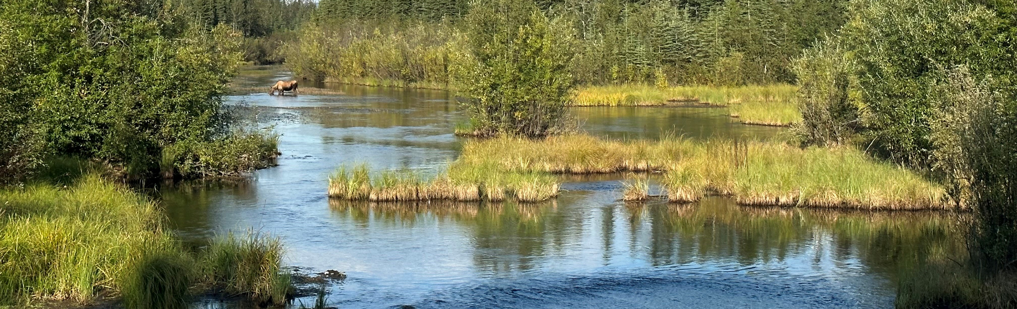
“Our family loves to fish. We used to fish in Piledriver Slough, a beautiful stream near Fairbanks,” said Patrice Lee, a mother and teacher in Fairbanks. “We have such wonderful memories of fishing there throughout the summer. It is heartbreaking that we can no longer fish this stream and other lakes in our area because of the PFAS contamination. It is time for our legislators to enact legislation to address PFAS as an urgent public health issue.”

Slide 20
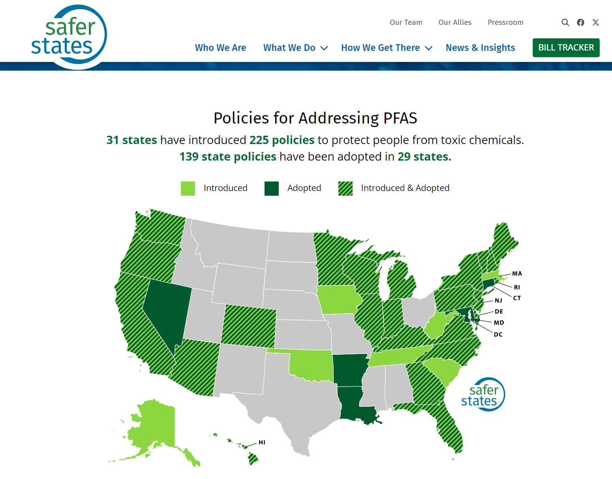
Resources

Slide 21
Thank you!
www.akaction.org
samarys@akaction.org

